Slide 1


Community Health Assistance (CHAs)/CHEWs Training Package

Slide 2
Overview of Family Planning

Slide 3
Definition
Family Planning:
The ability of individuals and couples to anticipate and attain their desired number of children, as well as the spacing and timing of their births.*
*Source: Working definition used by the WHO Department of Reproductive Health and Research

Slide 4
What's the Issue ?
% of women with unmet need
An estimated 225 million women in developing regions have an unmet need for modern contraception as of 2014 (1)
Of this total:
160 million were using no method
65 million were using a traditional method
Kenya: 20.1%
India: 20.8%
Nigeria: 22.6%
Tanzania: 27.8%
Uganda: 34.8%

Slide 5
Discontinuation Rates
36 percent of family planning users in Kenya discontinue using the method within 12 months of starting its use. (KDHS, 2008)
Discontinuation rates are highest for users of condoms (59 percent) and the pill (43 percent) and lowest for injectable (29 percent)

Slide 6
Unmet need for FP
Unmet need – the woman does not intend to get pregnant but is not on any FP method
25% of currently married women in Kenya have an unmet need for family planning, which remains unchanged since 2003 (KDHS, 2008)

Slide 7
Benefits of Family Planning
Improves health/well-being of families and communities
Mothers and babies are healthier when risky pregnancies are avoided.
Having more than 4 children makes childbirth riskier.
After having a child, it is healthier to wait at least 2 years to try to become pregnant again.
Smaller families mean more money and food for each child.
Parents have more time to work and to be with family.
Delaying first pregnancy lets young people stay in school.
Ideally, young women and men should wait until at least 18 years or have finished their education, and are ready before having children.

Slide 8
Policies around Family Planning
Counselling is an important pre-requisite for the initiation and continuation of a family planning method
Service providers must keep in mind that it is only condoms (male and female) that are known to provide protection against both STIs (including HIV), and pregnancy
Contraceptives should be provided to clients in accordance with the approved method-specific guidelines and job-aids, by providers who have been trained in provision of that method

Slide 9
Policies around Family Planning
All clients who choose a family planning method must be informed of the appropriate follow up requirements and be encouraged to return to the service provider should they have any concerns.
Clients that require or choose a method that is not available at a facility must be advised where the method can be obtained. Providers should follow the established referral system.

Slide 10
Policies around Family Planning
Service providers are expected to ensure they have consistent supply of methods available in order to offer clients choice.
Maintenance of an efficient logistic system avoids both commodity under-stocking and overstocking
All providers of family planning should maintain proper records on each client and the distribution of contraceptives

Slide 11
Policies around Family Planning
Everyone has a right to her or his own beliefs. However, health care providers have a professional obligation to provide care in a respectful and non-judgmental manner.
Service providers at all levels, whether public, mission or private, must at all times seek to provide quality services based on the Kenya Quality Model (KQM), and other quality improvement models

Slide 12
Young people and Family Planning
Service providers can encourage utilisation of family planning services by adolescents and youth by;
adopting positive attitudes
ensuring privacy
Confidentiality
convenient hours of service

Slide 13
Medical Eligibility Criteria
13
Notes:
13
Main message : that there a criteria that can be used to decide on suitability of FP methods:
the WHO MEC

Slide 14
Definition
Medical Eligibility criteria for starting use of contraceptive methods is based on WHO guidelines.
MEC helps a provider to decide whether a particular contraceptive method can be used, in the presence of a given individual characteristic or medical condition
Each condition is defined as representing either an individual’s characteristics (e.g., age ,history of pregnancy) or known pre-existing medical (diabetes, hypertension).

Slide 15
Purpose of the Medical Eligibility Criteria
To base guidelines for family planning practices on the best available evidence
To address misconceptions regarding who can and cannot safely use contraception
To reduce medical barriers
To improve access and quality of care in family planning

Slide 16
Utilization of evidence-based information
Research
Evidence
Utilization
MEC
Policies/
Strategies
Standards/Guidelines
Job Aids
Quality Health Services

Slide 17
Utilization of evidence-based information
Research
Evidence
Utilization
MEC
Policies/
Strategies
Standards/Guidelines
Job Aids
Quality Health Services

Slide 18
What Is Answered by WHO’s MEC?
In the presence of a given individual characteristic or medical condition, can a particular contraceptive method be used?

Slide 19
MEC CLASSIFICATION OF CATEGORIES
Category 1: A condition for which there is no restriction for the use of the method
Category 2: A condition where the advantages of using the method generally outweigh the theoretical or proven risks
Category 3: A condition where the theoretical or proven risks usually outweighs the advantages of using the method
Category 4: A condition that presents an unacceptable health risk if the contraceptive method
19

Slide 20
WHO Medical Eligibility Criteria Classification Categories
Classification | With clinical judgment | With limited clinical judgment
1 | Use method in any circumstances | Yes Use the method
2 | Generally use: advantages outweigh risks | Yes Use the method
3 | Generally do not use: risks outweigh advantages | No Do not use the method
4 | Method not to be used | No Do not use the method

Slide 21
WHO Classifications for Sterilization
A = Accept
C = Caution
D = Delay
S = Special
Notes:
Different classifications than for the temporary methods
A Accept There is no medical reason to deny sterilization to a person with this condition.
C Caution The procedure is normally conducted in a routine setting, but with extra preparation and precautions.
D Delay The procedure is delayed until the condition is evaluated and/or corrected. Alternative temporary methods of contraception should be provided.
S Special The procedure should be undertaken in a setting with an experienced surgeon and staff, equipment needed to provide general anaesthesia, and other back-up medical support. For these conditions, the capacity to decide on the most appropriate procedure and anaesthesia regimen is also needed. Alternative temporary methods of contraception should be provided, if referral is required or there is otherwise any delay.

Slide 22
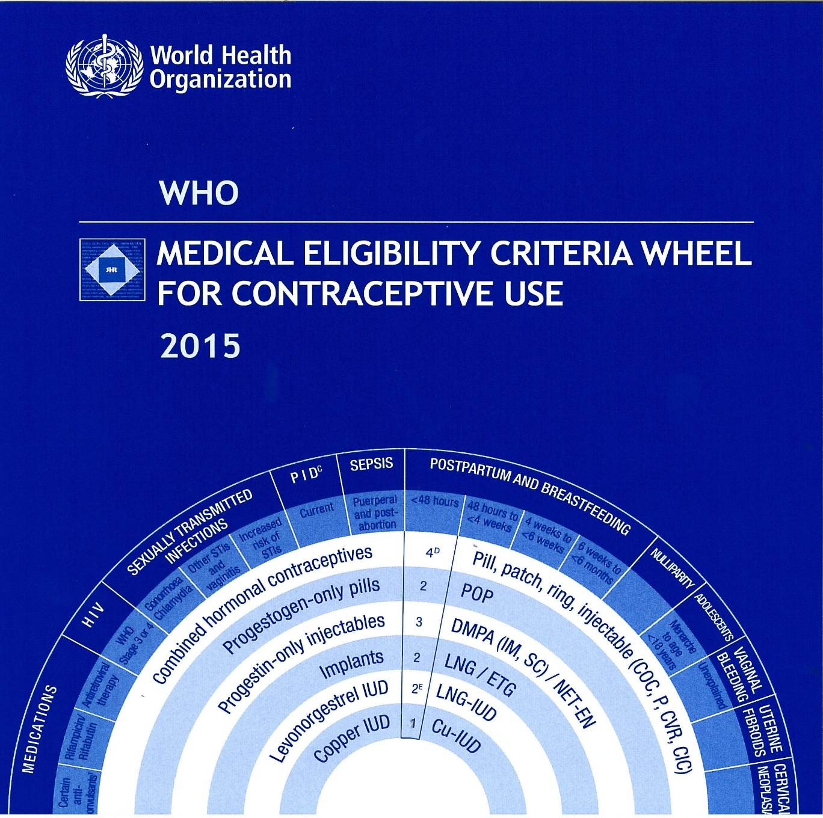
MEC Wheel

Slide 23
Combined Oral Contraceptives

Slide 24
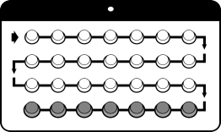
What is it
These are pills containing oestrogen and progesterone similar to the natural hormones in a woman’s body.

Slide 25
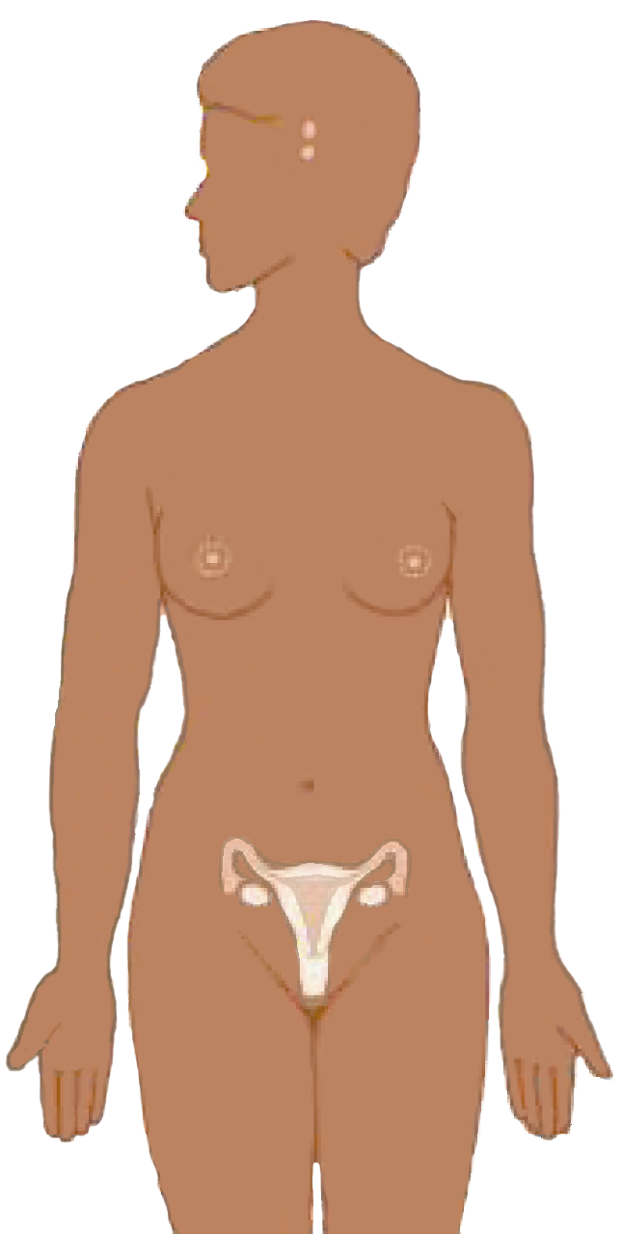
How Combined Pill works
Suppresses hormones
responsible for
ovulation
Thickens
cervical mucus to block sperm
Notes:
Other MOA: Injectables also thin the endometrium, thus reducing the chance that a fertilized egg would be implanted.
Discussion questions:
What do women in your community believe about how injectables work? In the event that there are misconceptions about how injectables work, how can you explain the mechanism of action in simple terms?

Slide 26
How to use
Take one pill every day for 21 days. Rest 7 days before starting a new packet (21 day packet)
If the packet has 28 pills e.g. femiplan, 21 pills have hormone while 7 are plain. In such a case take the pill daily till the last day and continue the next packet the following day.

Slide 27
Who can use COC
Sexually active women of reproductive age
Women of any parity, including nulliparous with established menses
Women who want highly effective protection against pregnancy
Breastfeeding mothers after 6 months postpartum
Women who can follow a daily routine of pill taking
Post-abortion clients

Slide 28
Who should not use COC.
Breastfeeding mothers before 6 months postpartum
Women who are pregnant or suspected of being pregnant
Women with unexplained or suspicious abnormal vaginal bleeding
Women with a history of blood clotting disorders
Women with a history of heart disease
Women with active liver disease
Women with hypertension
Women with complicated diabetes mellitus

Slide 29
When to start
Anytime of the menstrual cycle when the service provider is reasonably sure that the client is not pregnant.
Six months after delivery if breast feeding.
Within three weeks post delivery if not breastfeeding
Within seven days post abortion
Immediately when switching from another reliable method.
Between day 1 to day 7 of the menstrual cycle

Slide 30
Benefits
Highly effective
Effective immediately
Easy to use
Safe
Can be provided by trained non-clinical service provider
Return to fertility immediate
Reduces menstrual cramps and pain
Decreases menstrual flow hence prevention of anaemia

Slide 31
Limitations
Does not protect against STI/HIV/AIDS.
Some women have nausea, mild headaches and breast pains that usually go away after first few months.
Effectiveness is lowered when taken with other drugs e.g anti TB like Rifampicin, anti epilepsy drugs e.g. phenobarbitone, phenytoin)
Requires strict daily pill taking preferably at the same time every day
Affects quantity and quality of breast milk.
Effectiveness may also be lowered in the presence of gastroenteritis, vomiting and diarrhoea

Slide 32
Progesterone Only Pills (POPS)

Slide 33
Who should not use POPs ?
Mechanism of action
Women of any reproductive age or parity who:
Want to use this method of contraception
Cannot or should not take pills containing estrogen
Are breastfeeding (POPs do not suppress breast milk production)
POPs do not contain estrogen
Thicken cervical mucus making it hard for sperm to reach the egg
Partially inhibit ovulation (in 50% of cycles)
Notes:
33

Slide 34
Who should not use POPs
Suspected pregnancy
Current breast cancer
Liver disease
Women suffering from deep venous thrombosis (DVT)
Notes:
34

Slide 35
Advantages
Disadvantages
Slightly lower level of contraceptive protection than COCs
Requires strict daily pill taking, preferably at the same time
Does not protect one against STIs and HIV/AIDS
Side effects include:
Irregular spotting or bleeding, irregular cycles
Nausea
Breast tenderness
Headache
Safe
Effective, especially for breastfeeding women
Have no effect on breast milk
Easy to discontinue
Immediate return to fertility
Notes:
35

Slide 36
Emergency Contraception

Slide 37
Emergency Contraception
Emergency contraception (EC) is a safe and effective way to prevent pregnancy after unprotected intercourse

Slide 38
Types
Progestin only Contraceptives
Postinor -2 (2Tabs Stat within 120 hours after unprotected intercourse)
Microlut 26 Tabs at once within 120 hours after unprotected intercourse)
Combined oral contraceptives
Low dose pill e.g. Microgynon 4 stat and repeat after 12 hours
High dose pill e.g. Eugynon 2 stat and repeat after 12 hours
N.B The emergency contraceptive success rate is higher when give soon after unprotected sex

Slide 39
Mechanism of Action of ECPs
Mainly stops ovulation (release of egg from ovary)
Interferes with the movement of ovum and spermatozoa in the fallopian tube
!! ECPs do not disrupt existing (established) pregnancy and they are not effective once the zygote is attached to the uterus
39
Notes:
39

Slide 40
Who can use EC
EC may be necessary if :-
The condom broke or slipped off, and ejaculation is done in the vagina
One forgot to take the birth control pills
The diaphragm or cap slipped out of place, and ejaculation was done inside the vagina
One miscalculated the "safe" days
Withdrawal was not done in time
One was not using any birth control
One was forced to have unprotected vaginal sex, or was raped

Slide 41
Conditions where EC should be used with caution
Women with history of severe heart disease
Women who suffer from migraine headaches
Women with severe liver disease
Benefits
Provides emergency protection (prevents pregnancy) in about 75% to 95% of those at risk
Easy to use
Can be used any time during the menstrual cycle

Slide 42
Limitations
Only effective if used within 120 hours of unprotected intercourse
Do not protect against STI/ HIV
May cause
nausea and vomiting
slight irregular bleeding
!! It should be emphasised that emergency contraception should not be used on a regular basis (from month to month) because it is less effective than other methods.

Slide 43
Progestin Only Injectables

Slide 44
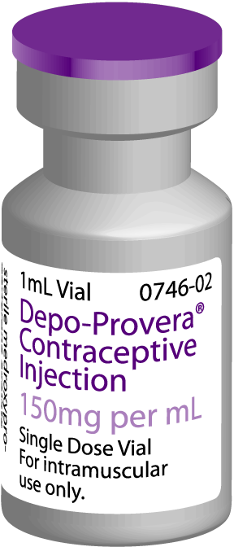
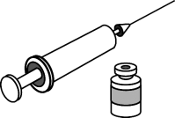
What is it
Contains progesterone
Depo-Provera is the most widely used injectable contraceptive
Injection given every 3 months
Notes:
DMPA, also known as Depo-Provera
DMPA is administered as deep intramuscular injection once every three months at a dose of 150 milligrams.
Injections may be given in the deltoid muscle of the upper arm or the gluteus muscle of the buttocks.
The deltoid is generally more accepted by women and is more easily accessed by the provider. The choice should depend mainly on the woman’s preference.
The active ingredients in DMPA are suspended in water, so the vial must be lightly shaken to dissolve any sediment at the bottom.
The injection site should not be massaged after the injection because that causes the hormone to be absorbed more rapidly than desired

Slide 45
Mechanism of Action
Suppresses Hormones responsible for ovulation
Thickens cervical mucus to block sperm
Notes:
Other MOA: Injectables also thin the endometrium, thus reducing the chance that a fertilized egg would be implanted.
Discussion questions:
What do women in your community believe about how injectables work? In the event that there are misconceptions about how injectables work, how can you explain the mechanism of action in simple terms?

Slide 46
Who can use Injectables
Women of any parity including nulliparous with established menses
Breastfeeding mothers after 6 weeks post partum
Post abortion clients
Women with uncomplicated diabetes, hypertension, valvular heart disease
Women with STI, PID,
Women with HIV/ AIDS and doing well on ARVs

Slide 47
Who should not use Injectables
Breastfeeding women less than 6 weeks
Women with liver disease
Women with breast cancer
Women with severe hypertension,
Women with unexplained abnormal vaginal bleeding
Women suffering from deep venous thrombosis (DVT)

Slide 48
Benefits
Highly effective
Safe
Easy to use
Long acting
Reversible
Can be discontinued without provider’s help
Can be provided outside of clinics
Use can be private
Has no effect on breastfeeding

Slide 49
Disadvantages
Side effects including
menstrual changes (irregular spotting or bleeding,
prolonged bleeding,
amenorrhea.
Headache, dizziness, nausea, breast tenderness,
Weight changes
After stopping the injections there may be delay in return to fertility
Does not protect against STI/ HIV

Slide 50
Implants

Slide 51
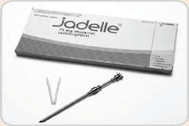
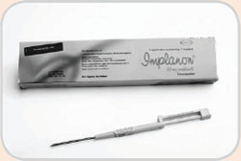
What are they
Progestin-filled rods or capsules that are inserted under the skin and release the hormone slowly over a long period to prevent pregnancy

Slide 52
Types
Jadelle : 2 rods, effective for 5 years
Implanon: 1 rod, effective for 3 years
Sino-implant (Zarin) 2 rods, effective for 5 years
Norplant: 6 rods, effective for 5 years

Slide 53
Mechanism of Action
Suppresses hormones
responsible for ovulation
Thickens cervical mucus to block sperm
Notes:
Other MOA: Injectables also thin the endometrium, thus reducing the chance that a fertilized egg would be implanted.
Discussion questions:
What do women in your community believe about how injectables work? In the event that there are misconceptions about how injectables work, how can you explain the mechanism of action in simple terms?

Slide 54
Who Can Use
Women:
Of any reproductive age
Of any parity including nulliparous women
Who want highly effective, long-term protection against pregnancy
With desired family size who do not want voluntary sterilization
Who are breastfeeding (after 6 weeks postpartum)
Who are postpartum and not breastfeeding
Who are post abortion
54
Notes:
6/21/2018
54

Slide 55
Who should not use Implants
Breastfeeding women less than 6 weeks
Women with liver disease
Women with breast cancer
Women with severe hypertension,
Women with unexplained abnormal vaginal bleeding
Women suffering from deep venous thrombosis (DVT)

Slide 56
Benefits
Highly effective
Rapidly effective ( within 72 hours)
Long-term method
Does not affect breastfeeding

Slide 57
Limitations
Must only be inserted and removed by trained providers
Require minor surgical procedure for insertion and removal
Common side effects include
menstrual changes (irregular spotting or bleeding, prolonged bleeding, and amenorrhea
headache, dizziness, nausea, breast tenderness,
weight changes
Does not protect against STI/ HIV

Slide 58
When to insert Implant
Anytime during the menstrual cycle when you can be reasonably sure the client is not pregnant
Days 1 to 7 of the menstrual cycle
Postpartum:
after 6 weeks if breastfeeding
immediately or within 6 weeks if not breastfeeding
Postabortion
immediately or within the first 7 days
58
Notes:
6/21/2018
58

Slide 59
Intrauterine Contraceptive Device (IUCD)
Notes:
Trainers notes :
IUCD, is one of the world’s most widely used family planning methods. It is the second most commonly used form of contraception, with the first being female sterilization.
IUCD is the most common form of reversible contraception worldwide
Currently, sixty-seven percent of IUD users live in China. However, IUD acceptance is growing in other parts of the world.

Slide 60
What it is
Mechanism of Action of Copper IUDs
Small, flexible, plastic "T“ device wrapped in copper wire that is placed in the uterus
Prevents sperm from meeting the egg by changing the uterine environment
Impairing the viability of the sperm
IUCD does NOT cause abortion

Slide 61
Mechanism of Action of Copper IUDs
Prevents sperm from meeting the egg by changing the uterine environment
Impairing the viability of the sperm
IUCD does NOT cause abortion
Source: Ortiz, 1996.
Notes:
Mechanisms of action of copper-bearing IUDs are still not completely understood. However, researchers believe that the main mechanism of action of copper-bearing IUDs is the prevention of fertilization. The presence of the IUD in the uterine cavity creates a local inflammatory reaction that appears to prevent sperm from reaching the fallopian tubes and through enhancing the debilitating effect on sperm.
Originally, it was thought that IUDs produced changes in the uterus that either destroyed a fertilized egg or prevented a fertilized egg from implanting in the uterus. Among your clients, what misunderstandings, if any, are there about how IUDs work?

Slide 62
Who Can Use Copper IUDs
Who Should Not Use Copper IUDs
Women of any age and parity
Women with medical conditions eg hypertension, heart disease, diabetes, Deep Venous Thrombosis (DVT)
Immediately after a delivery
High individual risk of STIs, AIDS
Pregnancy
When there is infection at the time of initiation;
Puerperal sepsis
Post abortion sepsis;
Pelvic inflammatory disease
Cervicitis
Pelvic tuberculosis
Unexplained vaginal bleeding
Endometrial or cervical cancer or ovarian cancer

Slide 63
Advantages
Disadvantages
Highly effective and safe
Does not interfere with intercourse
Easy to use
Long lasting (can be used for up to 12 years)
Easily reversible and quick return to fertility
No systemic effects
Can be removed any time if you want to get pregnant
Does not cause infertility
Side effects, including cramping and increased or prolonged bleeding in the first few months after insertion
Rare complications include perforation and pelvic inflammatory disease
Insertion and removal require trained provider
Does not protect against STI/HIV
Source: CCP and WHO, 2007.
Notes:
63
In addition to being highly effective and safe, the IUD has other characteristics that make it a good choice for many women. Use of an IUD does not interfere with intercourse. It is easy to use and requires little action on the part of the user and no active participation by a partner. The user only needs to check the IUD strings regularly to make sure the device is still in place.
The IUD is long lasting and easily reversible. The most commonly used IUD, the Copper T-380A, can remain in place for up to 12 years and possibly longer. If a woman wants to have a baby or to use another form of contraception, the IUD can be easily removed by a provider. Return to fertility typically occurs very soon after an IUD is removed. It has also been shown that the IUD can be used by women who have never had a baby without having any negative effect on their future fertility.
Copper-releasing IUDs act locally on the reproductive tract and have no systemic effects. For this reason, IUDs can be used safely by breastfeeding women. Serious complications are rare with IUD use.³ █
Illustration credits: Salim Khalaf/FHI; WHO
Reference:
3. World Health Organization/Department of Reproductive Health and Research (WHO), Johns Hopkins Bloomberg School of Public Health/Center for Communication Programs/INFO Project (CCP). Family Planning: A Global Handbook for Providers. Baltimore, MD and Geneva: CCP and WHO, 2007.

Slide 64
Timing of IUD Insertion
Interval insertion
Anytime during menstrual cycle if woman is not pregnant
Postpartum insertion
Immediately after vaginal or cesarean delivery if no infection or bleeding (within 48 hours)
Insertions after abortion
Immediately if no infection
Notes:
64
An interval insertion can be performed anytime during the menstrual cycle, as long as the woman is not pregnant. Some providers recommend the IUD be inserted during the last few days of menstruation when the cervical opening is a little larger than usual and it is certain the woman is not pregnant. However, it is easier to examine for signs of reproductive tract infections when a women is not menstruating. Therefore, IUDs can be inserted at the client’s convenience if the provider can be reasonably sure she is not pregnant. █
An IUD can be inserted postpartum. This assumes the provider has received adequate training in the procedure, the woman has been counseled appropriately prior to delivery, and there is no infection or bleeding. The IUD can be placed manually in the uterus immediately after a cesarean section delivery or a vaginal delivery. An IUD insertion following a vaginal delivery can be done during the first 10 minutes after delivery of the placenta. Early postpartum insertions within the first 48 hours are also considered safe. Otherwise, it is best to wait until the woman is four to six weeks postpartum, when the uterus returns to its normal size. █
An IUD can be inserted immediately after a first-trimester abortion if there is no infection. However, if the pregnancy was 16 weeks or more, IUD insertion should be performed by a specially trained provider or be delayed for six weeks.²⁴ █
Note to facilitator:
Take this opportunity to introduce the Checklist for Screening Clients Who Want to Initiate Use of the Copper IUD , included with the course materials. Mention that they will have opportunities to practice with these checklists during the counseling activities later in the training.
Reference:
24. World Health Organization (WHO). Selected practice recommendations for contraceptive use. Second Edition. Geneva: WHO, 2004.

Slide 65
IUD Use and Follow-up
Schedule follow-up visit at:
3 to 6 weeks (or during menses)
Counsel on side effects including signs of complications that require immediate return to the clinic)
Notes:
65
Another element of counseling is discussion of IUD use and follow-up care. █
Teach the client how to check for her IUD by feeling for the strings. Make sure that she knows to wash her hands thoroughly before inserting her fingers into her vagina. If she is unwilling or unable to check with her hand, she can be counseled to inspect carefully the pads she uses during menses to check for a possible expelled IUD. Emphasize the importance of routinely checking for strings after each menses, especially during the first six months, since this is when the IUD is most likely to be expelled. The client should be advised to use a backup method of contraception, such as condoms, and visit the provider as soon as possible if she notices the strings are missing. █
Schedule the client for a return visit three to six weeks after the insertion to check the position of the IUD strings and to check for signs of infection. If she has no problems at the time of her checkup or during the following months, she only needs to return to the clinic if she experiences problems or has concerns. █
Advise the client to return to the clinic immediately if she experiences any signs of possible complications.^{26, 27} █
Discussion question:
How do you help clients remember when to check their strings and when to return to the clinic?
References:
26. World Health Organization/Department of Reproductive Health and Research (WHO), Johns Hopkins Bloomberg School of Public Health/Center for Communication Programs/INFO Project (CCP). Family Planning: A Global Handbook for Providers. Baltimore, MD and Geneva: CCP and WHO, 2007.
27. World Health Organization (WHO). Selected practice recommendations for contraceptive use. Second Edition. Geneva: WHO, 2004.

Slide 66
Dispelling IUCD Myths
Are not abortifacients'
Do not cause infertility
Do not cause discomfort for the male partner
Do not travel to distant parts of the body
Are not too large for small women
Notes:
Both providers and clients may have false beliefs about IUDs. Replacing rumors with facts will help the user be more comfortable and satisfied with the method and more likely to continue using it.
To mitigate on strings being felt by the male partner, male involvement is crucial from the onset. Strings should not be cut too short.

Slide 67
Barrier Methods

Slide 68
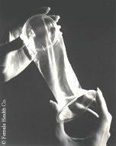

Condoms
Female condom
Male condoms

Slide 69
Mechanism of action
Prevents the sperm from gaining access to the upper reproductive tract, preventing it from meeting the egg.
In addition condoms offer the best protection against HIV and STI.

Slide 70
Advantages
Limitations
A new condom must be worn for each act of sexual intercourse
May cause itching for a few people who are allergic to latex
Effectiveness as contraceptives depends on willingness to follow instructions. Most effective when used correctly and consistently.
User-dependent (requires continued motivation and use with each act of intercourse).
Disposal of used condoms may be a problem. If not properly disposed of, may be a source of infection to others, especially children
Effective immediately
Do not affect breastfeeding
Can be used as backup to other methods
No known method-related health risks
No known systemic side effects
Widely available
No prescription or medical assessment is required
Inexpensive (in the short term)

Slide 71

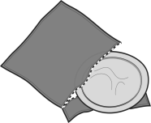




Dual protection and dual method use
Dual protection
(use of condoms for FP and for protection against STI/ HIV)
Dual method use
(Use another method for FP and condoms for protection against STI/ HIV
Condoms

Condoms
and
another family
planning method
Male condoms
Female condoms
or

Slide 72
How to Use a Female Condom

Slide 73
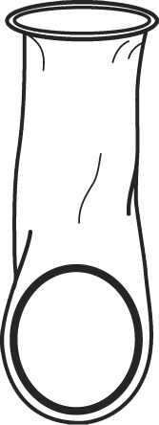
Step 1
Outer ring
Open package carefully
Make sure the condom is well-lubricated inside
Inner ring

Slide 74
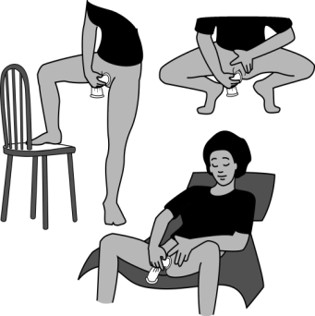
Step 2
Choose a comfortable position

Slide 75
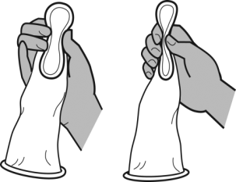
Step 3
Squeeze the inner ring, at the closed end

Slide 76
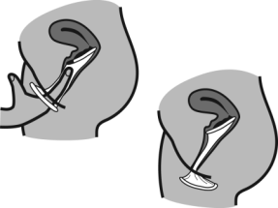
Step 4
Gently insert the inner ring into the vagina
Place the index finger inside condom, and push the inner ring up as far as it will go
Make sure the outer ring is outside the vagina and the condom is not twisted
Be sure that the penis enters inside the condom and stays inside it during intercourse

Slide 77
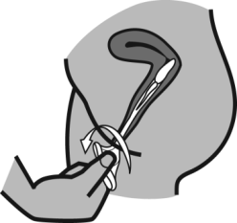
Step 5
Reuse is not recommended
To remove, twist outer ring and pull gently
Throw away condom safely

Slide 78
PERMANENT METHODS OF CONTRACEPTION

Slide 79
Introduction
Voluntary Surgical Contraception (VSC) includes female and male sterilization procedures that are intended to provide permanent contraception.
As such, special care must be taken to ensure that every client makes a voluntary, informed choice of the method.

Slide 80
Introduction
Particular attention must be given to counseling in the case of
young people,
nulliparous women,
men who are not yet fathers,
clients with mental health problems, including depressive conditions
All clients must be carefully counseled about the intended permanence of the sterilization and the availability of alternative, long-term, highly effective methods.

Slide 81
Medical Eligibility Criteria
There are no medical condition that would absolutely restrict a person’s eligibility for sterilization although some conditions and circumstances will require that certain precautions are taken, including those where the recommendation is C-Caution, D-Delay, or S-Special.

Slide 82
Definition of Conditions
A Accept: no medical reason to deny sterilization to a person with this condition.
C Caution: procedure is normally conducted in a routine setting, but with extra preparation and precautions.
D Delay: procedure is delayed until the condition is evaluated and/or corrected.
S Special: The procedure should be undertaken in a setting with an experienced surgeon and staff, equipment needed to provide general anesthesia, and other back up medical support.

Slide 83
Female Voluntary Surgical Contraception

Slide 84
Definition
A minor surgical operation, which involves the tying and cutting of the fallopian tubes in order to prevent the egg released by the ovary from being fertilized by sperm
Generally a safe procedure, and when performed by trained provider
Overall rates of complications are in the rage of 0.4-2.0%

Slide 85
Introduction
It is a highly effective method of contraception, failing in less than 1% of women in the first year after surgery.
Tubal ligation can be performed under conscious sedation and local anesthesia.
Tubal ligation is a permanent FP method (reversal cannot be assured). Hence, Thorough, careful counseling is needed before decision making.
A consent form must be signed by the client in all cases before the procedure is undertaken.
In the case of mentally challenged clients, a signature of the parent/guardian must be obtained.

Slide 86
Types
Minilaparotomy (postpartum or interval)
Laparoscopic tubal ligation-interval
At caesarean section or other abdominal surgery

Slide 87
Contraceptive Benefits
Highly effective
Immediately effective
No change in sexual function – does not interfere with intercourse
Good choice of FP for client if pregnancy would be a serious health risk
Does not affect breastfeeding

Slide 88
Limitations
Generally irreversible – success of reversal surgery cannot be guaranteed
Risks associated with surgical procedures
Pain
Haematoma
Wound infection
Does not protect against STIs/HIV/AIDS
Usually painful for a few days after the procedure
Can only be offered by a trained provider

Slide 89
Who Can Use Tubal Ligation (Category A)
Women of reproductive age
Women who are certain they have achieved the desired family size
Clients in whom pregnancy would pose a serious health risk
Women who understands and voluntarily follow informed consent procedure

Slide 90
Who Should Not Use
Clients who are uncertain of their desire for future fertility
Clients who cannot withstand surgery
Clients who do not give voluntary informed consent

Slide 91
Caution
Procedure can be conducted in a routine setting, but with extra preparation and precautions:
Young age
Obesity
Hypertension adequately controlled
History of ischaemic heart disease
Uncomplicated valvular heart disease
Epilepsy or
Depressive disorders
Uterine fibroids
Diabetes
Liver Cirrhosis and Liver tumors
Anemias
Previous abdominal or pelvic surgery
Kidney disease
Severe nutritional deficiency
!! Delay procedure until condition is evaluated and/or corrected

Slide 92
Special
Procedure requires experienced surgical team, equipment for GA,
Fixed uterus due to previous surgery, PID or endometriosis
Known pelvic TB
Hypertension complicated by vascular disease
Valvular heart disease-complicated
Diabetes with vascular complications
Liver Cirrhosis-severe
Coagulation disorders
Chronic respiratory disease
AIDS

Slide 93
VASECTOMY

Slide 94
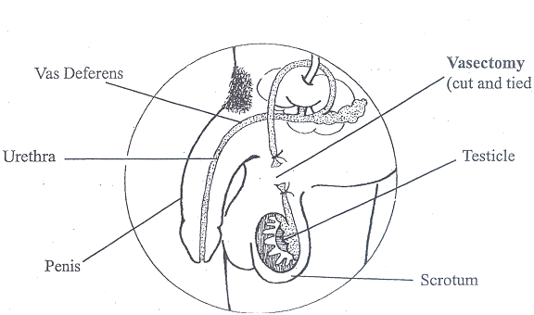
Definition
Surgical process of cutting the vas deferens in order to stop the sperm from mixing with semen, so that the semen is ejaculated without sperm.
Performed under a local anesthesia
Not synonymous with castration and does not affect sexual ability.
Has a failure rate of less than 1% in most studies.
Vasectomy does not become effective immediately. It is important that clients use condoms or another FP method for 3 months after the operation to be completely safe.

Slide 95
How Vasectomy Works
After vasectomy is done, a man continues to produce sperms and hormones.
The hormones are released into the blood stream, since the two vas deferens are blocked, the sperms produced by the testis have no outlet; therefore they are broken down and re-absorbed by the body as proteins.
Since the hormones that are responsible for manhood continue to be produced, a man who has had vasectomy continues to experience sexual arousal, erection and successfully engage in sexual intercourse and ejaculates satisfactorily.

Slide 96
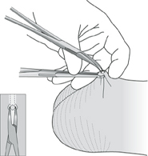
Techniques
Scalpel vasectomy
Non-scalpel vasectomy

Slide 97
Who Can Use Vasectomy
Men of reproductive age
Men who have achieved desired family size
Men who understand and voluntarily give informed consent for the procedure.

Slide 98
Limitations of Vasectomy
Not immediately effective
Not reversible (cannot be turned around to have babies)
No protection against HIV/STIs

Slide 99
!! CAUTION
Procedure can be conducted in a routine setting, but with extra preparation and precautions
Young age
Depressive disorders
Diabetes
Previous scrotal injury
Large varicocele or hydrocele
Cryptorchidism

Slide 100
DELAY
Delay procedure until condition is evaluated and/or corrected
Local skin infection
Active STI or Systemic infection
Filariasis or elephantiasis
Intra-scrotal mass

Slide 101
SPECIAL
Procedure requires experienced surgical
team, equipment for GA,
Coagulation disorders
AIDS
Inguinal hernia

Slide 102
Lactation Amenorrhoea Method (LAM)

Slide 103
Definition
The term Lactation Amenorrhoea Method (LAM) refers to the traditional method of breast-feeding as a family planning method
Mechanism of Action
Inhibits ovulation
For LAM to be effective the following criteria must all be met:
The baby is less than 6 months old
The baby is breastfeeding exclusively
The woman has not resumed her menses
When any of these 3 criteria is no longer met, another FP method must be introduced in a timely manner to ensure healthy birth spacing.

Slide 104
Advantages
Limitations
LAM provides temporary protection from pregnancy ( as soon as any of 3 requirements are not met, protection decreases)
No protection against STIs
Effectiveness after 6 months is uncertain
Exclusive breastfeeding may not be convenient for some women
Small chance of MTCT during breastfeeding if mother is HIV-positive,
Effective protection against pregnancy as long as all three LAM criteria are met
Does not interfere with sexual activity
No known health risks
Return to fertility is immediate
Affordable- no direct costs for family planning

Slide 105
Who Can Use
Women who:
Are fully or nearly fully breastfeeding
Have not had return of menses
Are less than 6 months postpartum¹

Slide 106
Natural Family Planning

Slide 107
Definition
Way by which a couple will learn to achieve or avoid a pregnancy by applying proper sexual behaviour during the fertile and infertile phases of the menstrual cycle.

Slide 108
Natural Family Planning methods
Checking cervical mucus (it becomes thin, watery and stretchable during the fertile period)
Basal body temperature (there is slight increase in body temperature during the fertile period)
Calendar/Rhythm method (calculating the fertile period from the menstrual cycle0
Standard Days method
Coitus interruptus

Slide 109
Who can use
All clients of reproductive age
Women with regular menstrual cycles
Couples willing to abstain from intercourse for more than one week each cycle
Couples who are able to maintain effective events records

Slide 110
Who should not use
Women with irregular cycles
Women who dislike touching their genitals
Women whose partners will not cooperate
Couples who want highly effective protection against pregnancy

Slide 111
Billing method
Identify start and end of the fertile period
A woman checks every day for any cervical secretion
The secretions have a peak day; when they are most slippery, stretch and thin, the couple continues to avoid genital sex until four days after the peak day.

Slide 112
Basal Body Temperature
The woman MUST take her body temperature in the same way either orally, rectally or vaginally at the same time each morning before she gets out of bed and record it on a special graph.
The temperature rises 0.20 – 0.50C around the time of ovulation (about midway through the menstrual cycle for many women).
The couple avoids sex, from the first day of menstrual bleeding until the woman’s temperature stays up for 3 full days. This means that ovulation has occurred and passed.
After this the couple can have sex over the next 10 –12 days until her next menstrual bleeding begins.

Slide 113
Calendar (Rhythm) Method
Before relying on this method, the woman records the number of days for each menstrual cycle for at least 6 months. The first day of menstrual bleeding is always counted as Day 1.
The woman subtracts 18 from the length of her shortest records cycle. This tells her the estimated first day of her fertile time, she then subtracts 11 days from the length of her longest cycle. This tells her the last day of her fertile time.
If her record cycles vary from 26-32 days;
26 – 18 = 8 (start abstinence on day 8)
32 – 11 = 21 (have sex after day 21)
Thus 14 days i.e. 8 – 21 of abstinence

Slide 114
Withdrawal (coitus interruptus)
Coitus interruptus is one of the traditional methods of birth control. A couple using the method may have intercourse in any way acceptable to them until ejaculation is about to occur, at which point the male withdraws his penis from the vagina and external genitalia of the female in order to prevent sperm from entering woman’s reproductive tract. .

Slide 115
Benefits Of NFP
No physical side effects
Free
Promotes involvement of male partner
Increases knowledge of reproductive system
Can be used either to achieve or avoid the pregnancy
Encourages couple communication and co-operation

Slide 116
Limitations of NFP
Low effectiveness
Effectiveness relies greatly on correct and consistent use
Requires daily record keeping
Vaginal infections interfere with normal mucus
Does not protect against STI, HBV, HIV/AIDS
Long period of training and counselling is required before use of the methods
Both partners must be willing to co-operate and participate
Frustration due to long abstinence

Slide 117
Standard Days or Cycle Beads Method

Slide 118
HOW DOES CYCLE-BEAD WORK?
They are a string of 32 color – coded Beads
Each Beads represents a day of a woman’s menstrual cycle
The Beads have a black rubber ring which a woman moves each day following the arrow
When the woman starts her menses, she moves the rubber ring on to the Red Bead
She continues moving the ring, one bead each day of her menses
When the ring is on the very Dark Bead, she can have sexual intercourse without worrying of becoming pregnant
When she is on the white Beads she may become pregnant if she has unprotected sexual intercourse

Slide 119
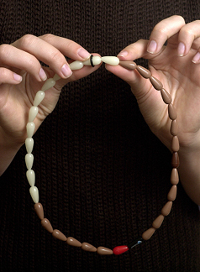
The Standard Days Method
Identifies days 8-19 of the cycle as fertile.
Is for women with menstrual cycles between 26 and 32 days long.
Helps a couple avoid unplanned pregnancy by knowing which days they should not have unprotected intercourse.
A client can use a color-coded string of beads to help her keep track of where she is in her cycle and know when she is fertile.

Slide 120
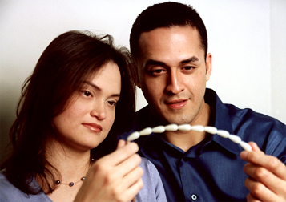
Who Can use this Method?
All women of reproductive age
Women with cycles between 26 and 32 days long
Couples who can avoid unprotected intercourse on day 8-19 of each cycle
Couples not at risk of STIs
Couples who are to maintain effective events of records
Women with regular menstrual cycle

Slide 121
Who Cannot use this Method?
Women who are suspected or known to be pregnant
Women with irregular menses
Women who dislike touching their genitals
Women whose partners will not cooperate
Women whose menstrual period are not regular

Slide 122
Service Delivery Process
Determine if the client is interested in using SDM
Screen for cycle length, ability to avoid unprotected intercourse on fertile days, STI risk
Explain Standard Day Method
Demonstrate CycleBeads
Have client give a return demonstration
Verify understanding/acceptance
Provide Cyclebeads, other materials

Slide 123
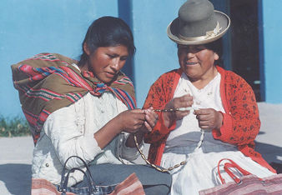
Summary
Standard Days Method is a simple method that fills a family planning gap
Based on probabilities of becoming pregnant during the menstrual cycle
Uses a string of beads to represent the cycle and identify days 8-19 as days to not engage in unprotected sex

Slide 124
Lessons Learned
Demand exists
It is effective
SDM is easy to learn and use
Many willing and able to use SDM
Correct use improves over time
Many men can and do support their use
Involving men is key to successful use
Some will prefer to use with condoms
Need to educate providers

Slide 125
WILL CYCLE – BEADS PROTECT ME FROM STIs, HIV/AIDS?
No
Like any other Family Planning Method one is not protected from STIs, HIV/AIDS
WHERE CAN I GET CYCLE-BEADS ?
You can order them from Division of Reproductive, Ministry of Health

Slide 126
Can Anyone Use Cycle Beads?
No
Only women whose menstrual cycles are between 26 and 32 days long
According to WHO data about 80% of women have their cycles within this range

Slide 127
LIMITATIONS
Those women who have shorter days than 26 or longer days than 32 are not good candidates
Those women who cannot avoid sexual intercourse during the fertile days
HOW MANY WOMEN HAVE CYCLE LENGTHS THAT ARE BETWEEN 26 AND 32 DAYS LONG?
According to WHO data about 80%
Most women have their cycles within this range

Slide 128
Myths and Misconceptions about Family Planning

Slide 129
Examples of Rumors and Misconceptions
Condoms have holes
Condoms are laced with the HIV virus
Contraceptives encourage immorality
Contraceptives make women barren
Family Planning causes mental retardation in children
Contraceptives cause cancer
Family Planning is a way of reducing the African Population
IUCD can disappear into the rest of the body
Contraceptives make a woman cold and dry
Contraceptives reduces libido
Vasectomy is castration
Contraceptives make breast milk disappear
Adapted from MOH-CBD Curriculum

Slide 130
Reasons for Rumors and Misconceptions
Correcting Rumors and Misconceptions
Always listen politely and don’t laugh!
Define rumors and misconceptions
Provide facts and education
Be persistent – repeatedly remind of the facts
Communicate effectively
Be a good example/ Role model
Reinforce having many children as a “positive” if one can cater for them
Choice of appropriate methods for each person
Proper counselling and medical history
Lack of correct information
Inadequate information
Deliberate propaganda
Illiteracy
Ignorance
Negative beliefs
Religion
Adapted from MOH-CBD Curriculum

Slide 131

Inventory Management For Family Planning (FP) Commodities

Slide 132
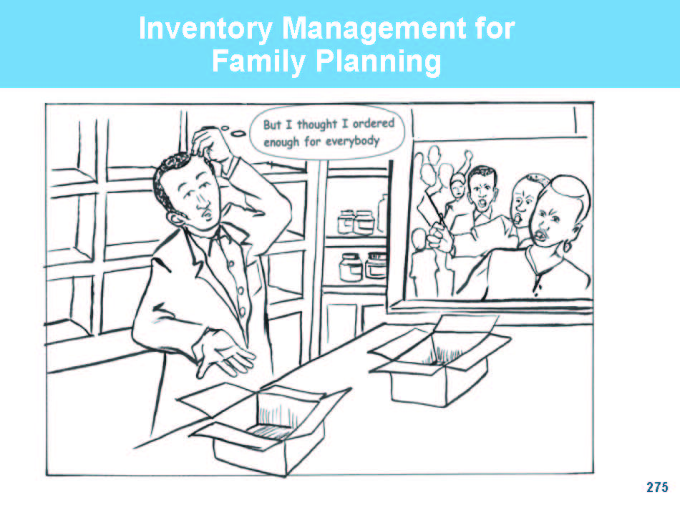

Slide 133
Learning Objectives
By the end of this overview, participants should be able to:
Describe the main components of inventory management .
List examples of FP commodities .
List the tools used in inventory management.
Discuss the importance of inventory record-keeping and reporting

Slide 134
Inventory Management
Inventory management is the process that ensures proper ordering, receipt, storage, and use of commodities.
The components include:
Determining order quantities
Receiving commodities
Storage
Issuing commodities
Record-keeping

Slide 135
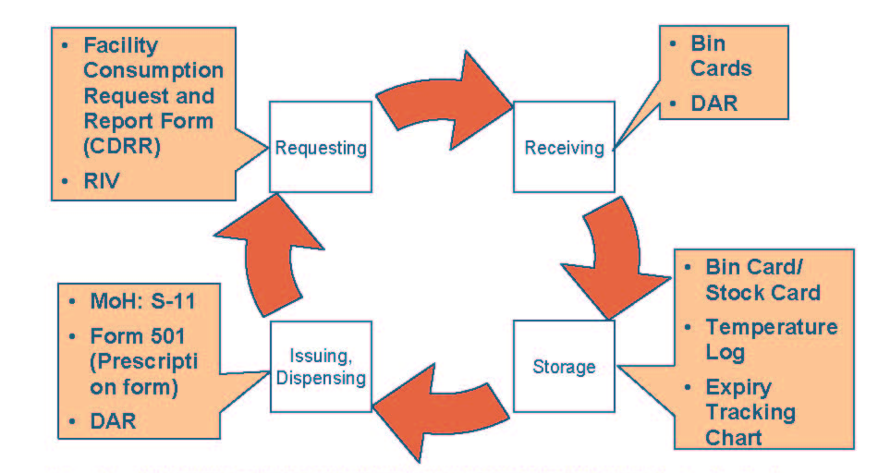
The Inventory Cycle And Inventory Management Tools
Adapted from MANAGEMENT SCIENCES FOR HEALTH (MSH) IN COLLABORATION WITH WHO. (1997). Managing Drug Supply. 2nd edition. (Kumarian Press).

Slide 136
Commodity Management
The Health Care Provider (HCP) needs commodities to provide FP services at any service delivery point, e.g., MCH/FP and CCC.
RH commodities include the following:
Contraceptives (all types)
Disposables (syringes and needles)
STI/RTI drugs and medical supplies
Drugs and Equipment for Reproductive Tract (RT) Cancers
Drugs and Equipment for Essential Obstetric Care (EOC)
Drugs and Equipment for Post Rape Care (PRC) Kit
Once availed, commodities need to be appropriately stored, used, and accounted for.

Slide 137
Relevant Tools for RH Inventory Management
Contraceptive Data Report and Request (CDRR) Tool - Used for reporting and requesting commodities for all facilities
Standard Order and Requisition Form- Used for reporting and requesting commodities for “Pull” facilities
BIN Cards
Store records for goods received and issued
Daily Activity Register (DAR) - Used to capture service data and commodity use(logistics) data
Request and Issue Voucher (RIV/S11) - Used for ordering and issuing commodities

Slide 138
Record Keeping
For each FP commodity, the HCP needs to record:
Date of transaction involving the commodity
Name of commodity.
Quantity of commodity received.
Quantity of commodity issued to clients. Quantity expired, damaged, or lost .
Ending balance for specified time interval, e.g., at the end of the month.

Slide 139
Importance of Commodity Utilization Reports
Commodity utilization reports provide information on:
Quantities of commodities available at various levels
Quantity of commodities needed for resupply
Commodities requiring redistribution
HCP workload (how much workload the HCP has experienced over the reporting period)

Slide 140
Challenges For M&E in Commodity Management
Timeliness: Late reporting
Incomplete reports
Incorrect reports
Non-reporting sites: how to make good resupply decisions

Slide 141
Storage
Definition: A store is a structure or room where commodities are kept for safety and are available to users as and when required.
Reason for storage:
Safety of commodities from theft and Damage
Easy accessibility
Easy monitoring and planning
To ensure uninterrupted supplies

Slide 142
Storage Guidelines
These are the laid down standards on how to store commodities. It means that commodities are kept in such a manner to protect their quality and integrity while, at the same time, making them available for use (It is how the commodities are stored)

Slide 143
Guidelines
Clean and disinfect storeroom regularly, and take precautions to discourage harmful insects and rodents from entering the storage area
Store health commodities in a dry, well-lit, well-ventilated storeroom -out of direct sunlight
Protect storeroom from water penetration
Maintain cold storage, including a cold chain as required
Arrange cartons/boxes with arrows pointing up and with identification labels, expiry dates and manufacturing dates clearly visible
Store health commodities to facilitate “first-to-expire, first-out” (FEFO) procedures and stock management

Slide 144
Departmental Linkages for FP commodities
All relevant departments should link up for needed FP commodities e.g., the bulk store, pharmacy, and MCH
Dispensing data from all departments should be aggregated and reconciled with that of the MCH/FP and pharmacy for the required periodic reports.

Slide 145
Monitoring & Evaluation
Data collected by facilities is used nationally to calculate:
Proportion of health facilities offering RH/FP services
Number of clients accessing integrated RH/FP services in Health facilities
Number of facilities with no RH/FP commodities stock outs
Proportion of health facilities providing comprehensive and integrated RH/FP services

Slide 146
The Intrepid SMS Reporting System

Slide 147
About Intrepid…
Intrepid is a simplified electronic tool for reporting and requesting Family Planning (FP) Commodities
Data is captured via an SMS message sent to an assigned number
The SMS data is automatically forwarded to a web interface where the data is displayed and can be analyzed – for action.
Intrepid enables an easy way of stock monitoring in Districts thereby enabling immediate reactions to identified gaps
Data from facilities can be shared between different stakeholders – DRH, KEMSA, District RHCs, etc. for immediate decision making.

Slide 148
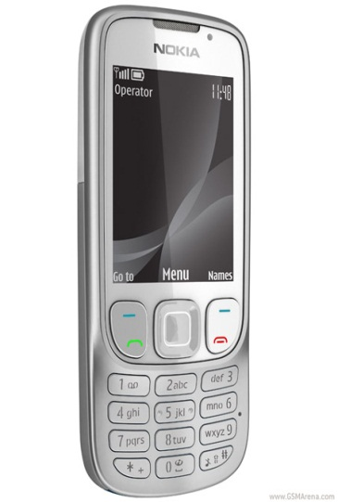
Basic Requirements of the Intrepid SMS reporting System
Mobile phone hand-set
Mobile phone air-time
Job Aids
Reference Booklet
Reference pocket card
Data sources
Contraceptives CDRR
Contraceptives DAR
Computer and Internet

Slide 149
Functions of the Intrepid SMS Reporting System
Reports FP commodity stocks at the facility level
Placing of FP commodity orders when need arises
Reports FP commodity stocks received from KEMSA
Reports FP commodity stocks received from other sources or Issued to other facilities (+ve and –ve adjustments)
Allows for calculation of periodic FP commodity consumption

Slide 150
PRODUCT CODES
Male Condom
(Depo Provera) Depot Medroxyprogesterone acetate (DMPA 150 mg)
(Microgynon) (COC) Levonorgestrel /Ethinylestradiol tab (0.15 mg/0.03 mg)
Female Condom
(Jadelle) Levonorgestrel implant 75 mg
IUD Copper T
(Microlut) (POP) Levonorgestrel tab 30 mcg
(EC) Levonorgestrel tab 750 mcg, Pair
Cycle beads
(Implanon) Etonorgestrel Implant 68mg

Slide 151
REPORTING PROCESS

Slide 152
Intrepid SMS Reporting process
No spaces are to be included in the SMS process steps
Send a separate SMS for each product
Step 1
Create a new message in your phone and add the numerical value for the product you are reporting i.e. Product code e.g. 1 (for male condom), then insert the hash (#) symbol
Step 2
Insert the letter B for Opening Balance, then the numerical value followed by the hash (#) symbol
Step 3
Insert the letter C for Closing Balance, followed by its numerical value and then the hash (#) symbol

Slide 153
Intrepid SMS Reporting process
Step 4
Insert the letter Q for Quantity Ordered, followed by the numerical value and the hash (#) symbol
Step 5
Insert the letter R for Received Quantity , followed by the numerical value and the hash (#) symbol
Step 6
This step can be included where adjustments in the stocks have been made, either positively or negatively. Positive adjustments are stocks that the facility has received in form of borrowed stocks or donations. Negative adjustments are stocks that the facility has given out or lent to another facility.
Insert the letter AP (Adjusted Positively) or AN (Adjusted Negatively) followed by the numerical value for the adjustment

Slide 154

Intrepid SMS Reporting process
Step 6
Your message should look like the examples below
1#B1000#C500#Q5000#R4000
or
1#B1000#C500#Q5000#R4000#AP250
Once your message is in order, send it to the number
0732 238 164
Kindly note that the letters can be in either capital or small letters
You will get an Automated acknowledgement reply when the message is received

Slide 155
The SMS Sequence
CODE
Add the numerical Product Code you are reporting e.g. 1 ( for male condom)
Insert the symbol #
B
Insert the letter B (Opening Balance) and then the numerical value
Insert the symbol #
C
Insert the letter C (Closing Balance) and then the numerical value
Q
Insert the letter Q (Quantity Ordered) and then the numerical value
AN
AP
Insert the letter AP (Adjusted Positively – e.g. Received donations or borrowed stocks) and then the numerical value OR
Insert the symbol #
Insert the symbol #
R
Insert the letter R (Quantity Received ) and then the numerical value
Insert the symbol #
Insert the letter AN (Adjusted Negatively - e.g. Stocks given out to another facility) and then the numerical value
So for example your SMS sequence looks like this …..
1#
B5000#
C2500#
Q2500#
AN150
SEND TO 0732 238 164
R 2000

Slide 156
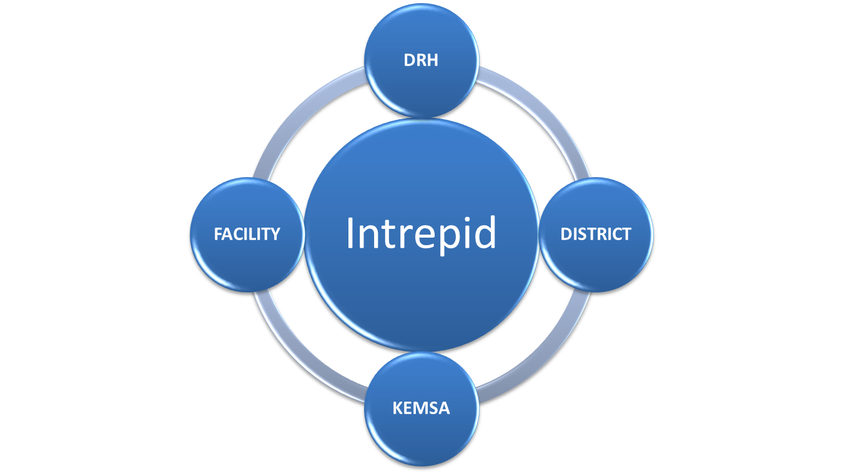
The Intrepid Interface
Where a disconnect is identified – an intervention can be made immediately

Slide 157
Stakeholder Roles and Responsibilities

Slide 158
Roles & Responsibilities (1)
Facility In-charge:
The Facility in-charge or a designated assistant trained on Intrepid should SMS their FP commodity stocks report by the 5th of every month, or when they run out of stock for any commodity
The quantity ordered should be sufficient for 3 months + one month’s buffer stock:
Quantity ordered = (Opening Balance –Closing Balance) X 4 months (3 regular + 1 month buffer)
They should ensure the Intrepid report and the CDRR tally except for SMS reports sent between the month when a stock-out is experienced

Slide 159
Roles & Responsibilities (2)
District RH Coordinators:
Retain a copy of the SDP CDRR form for the Tupange team to be collected by the 8th of every month
They should contact Tupange Commodity Security Officers incases where FP commodity supplies have not been made or when stocks in the district store run out
Coordinate re-distribution of FP commodities within facilities in the district after receiving the monthly or pre-monthly report(s)

Slide 160
Roles & Responsibilities of (3)
Tupange Team:
Make calls to facility in-charges or their designated deputies to remind them to SMS their reports on 3rd of every month
Confirm and acknowledge receipt of all reports received – both the Intrepid SMS Reporting system and CDRR copies
Follow-up with DRH and KEMSA to ensure FP commodities are supplied on time and in sufficient quantities
Support re-distribution of FP commodities between facilities in the district.

Slide 161
Advantages of the intrepid system
Facilitates immediate reaction to sudden stock fluctuations, either over- or under-stocks
Minimizes data quality challenges due to use of manual tools
Minimizes delays in reporting
Allows reporting to be done at any time of the month and not necessarily at the end
It forms an interface with all key sectors in the FP commodity supply chain cycle and therefore avails the necessary data to all at the same time

Slide 162
Conclusion
Timely, accurate, complete and consistent reporting is the key to an efficient Logistics Management Information System (LMIS).
The LMIS is the main source of information for any supply chain system and is important for planning, financing, procurement and distribution of Family Planning commodities.
The Intrepid SMS reporting system uses current mobile phone technology to ensure efficient and convenient reporting and allows for speedy and accurate decision making.

Slide 163


Provider-Initiated Family Planning (PIFP)
PIFP
Ask me about FP

Slide 164
What is PIFP ?
Refers to family planning provision which is recommended by health care workers to women and men of reproductive age attending health care facilities as part of routine medical care
The main purpose is to ensure no missed opportunity to offer FP
It is a new strategy to improving integration of FP services in clinical settings

Slide 165
Rationale for PIFP
Assists to identify clients’ unmet need for Family Planning and make client aware of FP
Facilitates integration of FP and other clinical services
Is a cost effective approach for clients

Slide 166
Benefits of PIFP
To Clients
Client is able to determine his/her need for FP
Is cost effective as client is able to get multiple services during the same visit
Reduces risk of unwanted pregnancies
To service providers
Assists to comprehensively meet client FP needs
Helps offer better quality service
To health facility
Leads to increased FP uptake in all service areas

Slide 167
The PIFP Process
PIFP
Determine client’s FP needs
Use the 4 screening questions
Provision of FP service
FP service includes
Documentation
In appropriate tools (FP register, Mother Child Booklet)
1. FP information and counselling
2FP method provision
3. Linked referral (within/outside facility)
Ask me about FP

Slide 168
Screening Questions for FP need
These set of guided questions help service provider quickly identify who needs FP information, counselling, service and/or referral
Q1 Do you have children ?
Q2 Would you like to have a child soon ?
Q3 Are you using any FP method?
Q4 Do you want to use an FP method? (See screening job aid for details)

Slide 169
Implementation of PIFP
Conduct whole-site orientation of health facility staff (clinical and non-clinical) on family planning
Identify service areas within the facility where PIFP can be implemented
Train service providers in these areas on PIFP approach including orientation on job-aids, data tools and referral tools
Provide supporting IEC materials, job aids, badges (“ask me about FP”)
Identify a PIFP champion in the department /facility to fast-track implementation
Conduct periodic trainee follow-up and mentorship visits to address service provider challenges
Conduct supportive supervision for quality assurance
Review records and track referrals to evaluate FP uptake

Slide 170

Who can Provide PIFP
Provider/ Method | Male/Female Condom | Pills (COCs, POPs, ECs) | LAM | Injectable | SDM | IUCD/Implants | Permanent method (BTL, NSV)
Medical Doctor | Info, counsel & Provide | Info, counsel & Provide | Info, counsel & Provide | Info, counsel & Provide | Info, counsel & Provide | Info, counsel & Provide | Info, counsel & Provide
Nurse/Midwife | Info, counsel & Provide | Info, counsel & Provide | Info, counsel & Provide | Info, counsel & Provide | Info, counsel & Provide | Info, counsel & Provide | Info, counsel and refer
Clinical Officer | Info, counsel & Provide | Info, counsel & Provide | Info, counsel & Provide | Info, counsel & Provide | Info, counsel & Provide | Info, counsel & Provide | Info, counsel and refer
Pharmacy Staff | Info, counsel & Provide | Info, counsel & provide | Info, counsel & Provide | Info, counsel, sell refer for injection | Info, counsel & Provide, refer | Info, counsel, sell, refer | Info, counsel and refer
Other clinical staff (nutritionists, PHTs)
CHW | Info, counsel & Provide | Info, counsel & provide | Counsel, support, refer | Info, Counsel & refer | Info, counsel, provide, refer | Info, Counsel & refer | Refer
Adapted from Kenya National FP Guidelines

Slide 171
Possible Integration Areas
Each health facility will decide the level of integration
Possible integration sites:
MCH,
HIV Counseling and Testing
CCC,
Out Patient Department,
PAC,
Maternity,
TB clinic,
ANC

Slide 172
Potential Challenges
Increased workload for service providers-Increased uptake of FP will eventually reduce client load
Untrained service providers in FP provision-Routine CMEs will update all service providers in FP
Increased time taken with one patient-will eventually reduce client load
No registers to collect FP data-Tupange to provide tools for data collection and orientation on the same

Slide 173
Monitoring and data collection
Number of clients receiving FP at various service points
Number of patients being referred for FP from specific service points (within and outside the facility)

Slide 174
Infection Prevention

Slide 175
Infection Prevention
IP in RH and health care facilities has two objectives:
To prevent major post-operative infections when providing clinical contraceptive methods (e.g., IUCDs, Injectables, implants, and male and female voluntary sterilization); and
Prevent the transmission of serious diseases, such as hepatitis B and HIV, not only to clients, but also to service providers and staff

Slide 176
Recommended IP practices for FP providers
Consider every person (client or staff) potentially infectious.
Wash hands. This is the most practical procedure for preventing cross-contamination (person to person).
Wear gloves before touching anything wet, such as broken skin, mucous membranes, blood, or other body fluids (secretions or excretions); soiled instruments; and other items.
Use safe work practices, such as not recapping or bending needles, safely passing sharp instruments, and properly disposing of medical waste.
Isolate patients only if disease is contagious and secretions (airborne) or excretions (urine or feces) cannot be contained.
Get vaccinated for hepatitis B virus (HBV).

Slide 177
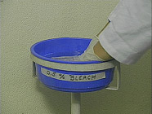
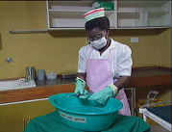
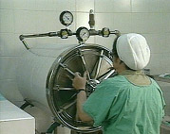
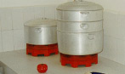
Instrument Processing
Decontaminate
High-Level Disinfect
Boil
Steam
Chemical
Chemical
High pressure steam
Dry heat
Sterilization
Clean
Dry/Cool and Store

Slide 178
Handwashing
Single most important IP Practice
Wash hands before and after examining or
treating each client.
Use clean water and plain soap, and rub hands
for at least 10 to 15 seconds. Dry hands with a paper towel or a clean, dry individual cloth towel

Slide 179
Instrument Processing
Decontaminate all instruments by soak items in a 0.5% chlorine solution for 10 minutes
Clean instruments with brush, detergent and clean water. HLD and sterilization is not effective without proper cleaning
High-level disinfect or sterilize instruments that touch intact mucous membranes or broken skin
Sterilize instruments that touch tissue beneath the skin

Slide 180
Wear gloves
Wear single-use examination gloves for procedures that touch intact mucous membranes. Gloves are not necessary for giving injections.
Change gloves between procedures on the
same client and between clients.
Do not touch clean equipment or surfaces with
dirty gloves or bare hands.
Wear clean utility gloves when cleaning soiled instruments and equipment, handling waste, and cleaning blood or body fluid spills.

Slide 181
Do pelvic exam only when necessary
Pelvic examinations are not needed for most
family planning methods—only for female
sterilization and the IUCD

Slide 182
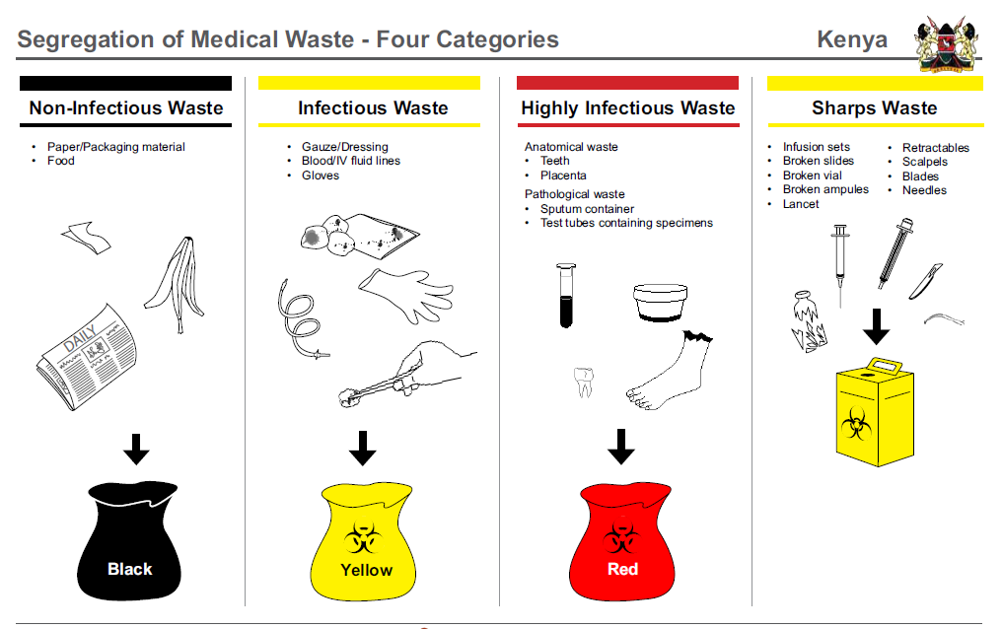
Medical Waste Segregation
Trainer Reference Material: National Infection Prevention and Control Guidelines for Health Care Services

Slide 183
Postpartum Family Planning

Slide 184
What is Post Partum Family Planning (PPFP)
The initiation and use of family planning methods following delivery up to 1 year after delivery. The timing of PPFP may be:
Post-placental – within 10 minutes after delivery of the placenta
Immediate postpartum – delivery to 1 week
Postpartum – 1 week up to 6 weeks
Extended postpartum – 6 weeks to one year after delivery

Slide 185
Factors affecting timing and choice of FP
Breastfeeding status
Method of choice
Reproductive health goal/fertility desires
Medical Eligibility Criteria (MEC) for the method of choice
Women not breastfeeding may use any method of FP but need to conform to the MEC for that method.

Slide 186
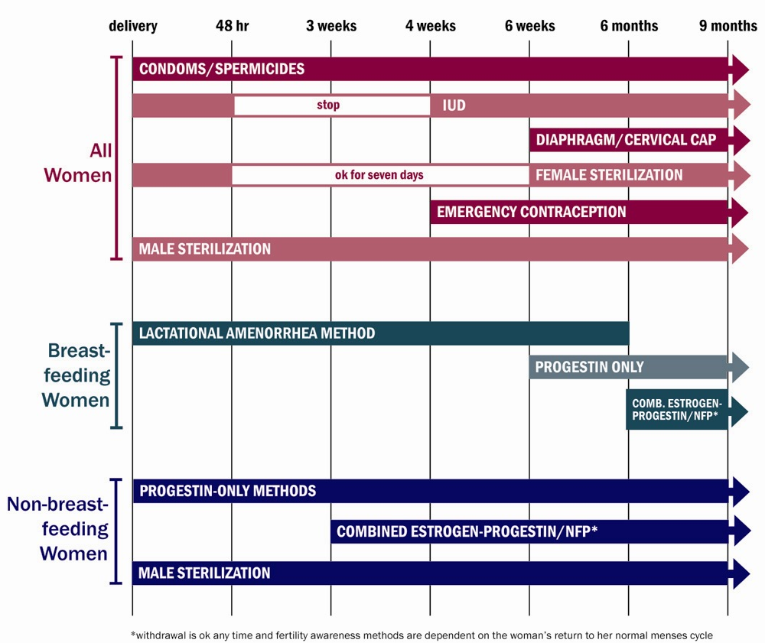
When Can Postpartum FP be Initiated ?

Slide 187
Timing of visit
Antenatal
Intrapartum
Counseling on all methods of FP including the timing of initiation for each
Understand the reproductive goal of the client
Does she want to space births?
Does she want to stop childbearing after this pregnancy?
Counsel on importance of FP
Counsel on methods available intrapartum:
Intrapartum female sterilization
IUCD insertion during caesarean section
Advise on Lactational Amenorrhea method (LAM)

Slide 188
Timing of Visit – within 48 hours of birth
Focused physical exam
Counseling on importance of FP
Counsel on FP methods that can be used within 48 hours of birth
Advice on LAM
Postpartum Female Sterilization
IUCD insertion immediately after delivery up to 48 hours

Slide 189
Timing of visit 1or 2 weeks after delivery (preferably within one week)
Focused physical examination
Counsel on HTSP messages, return to fertility, and sexual activity
Available methods of FP in this period:
Condoms
LAM
Progestin only pills if not breastfeeding
Discuss when to initiate FP methods based on breastfeeding status

Slide 190
Timing of visit 4 to 6 weeks after birth
Focused physical examination
Counsel on HTSP messages, return to fertility, and sexual activity
For LAM users: Supportive counseling on transition to other FP methods
Counseling and provision of, or referral for, all other FP methods as appropriate. This will be based on:
Breastfeeding status
Other medical eligibility criteria (MEC)
client’s choice
Counseling on dual method use

Slide 191
Timing of visit Between 4 and 6 months
Reassess fertility desires/ goals
For LAM users: supportive counseling on transition to other FP methods (preferably initiated before LAM expires)
Counseling and provision of, or referral for, all other FP methods based on breastfeeding status

Slide 192
Postpartum IUCD
IUCDs can be inserted:
Immediately after delivery of the placenta
During caesarean section
Within 48 hours of childbirth
If not inserted within 48 hours of delivery, insertions should be delayed until four weeks after childbirth
IUCD does not affect quantity or quality of breast milk
Immediate postpartum insertion should not be done for women who had ruptured membranes for more than 18 hours before delivery - there is increased risk of infection.

Slide 193
IUCD - Timing of Insertion and Expulsion Rates
Time of IUCD Insertion | Definition | Expulsion rate | Observations
Post-placental | Within 10 minutes after delivery of placenta | 9.5 – 12.5% | Ideal: Low expulsion rates
Immediate postpartum | After 10 minutes to 48 hours post delivery | 25 – 37% | Still safe
Later postpartum | After 48 hours to 4 weeks post delivery | NOT RECOMMENDED | Increased risk of perforation and expulsion
Interval – Extended Postpartum | After 4 weeks post delivery | 3 – 13% | Safe

Slide 194
Postpartum Female sterilization
Ideal time is within 48 hours after delivery
Timing for female sterilization
Can be done during caesarean section
Immediately following a delivery
If sterilization is not performed within one week of delivery, delay for six weeks due to increased risk of infection

Slide 195
Progestin only Pills
Progestin only Injectables
e.g. Depo Provera
Safe for breastfeeding women – no effect on breastfeeding, milk production or infant growth and development AFTER infant is 6 weeks old
Adds to the contraceptive effect of breastfeeding
Less effective for non-breastfeeding mother
No effect on breastfeeding, milk production or infant growth and development
Safe for use after infant is 6 weeks

Slide 196
Combined oral contraceptives (COCs)
Emergency Contraceptives
Not recommended in breastfeeding women less than 6 weeks old – can reduce milk production
Can be initiated 3 weeks after delivery if women is not breastfeeding and 6 months after delivery if breastfeeding
Progestin only regimens are safe for breastfeeding woman
No need for Emergency Contraception before 21 days after childbirth

Slide 197
Barriers to PPFP service and method
Lack of information
Lack of awareness of health benefits of spacing
Shifts in traditions that protected from pregnancy – postpartum abstinence
Lack of knowledge about fertility return
Misconceptions
Misconceptions about breastfeeding as a method of FP (LAM)
Misconceptions about safety of FP for Breastfeeding women
Social support
Spousal permission
Lack of support from mother in law or other relatives
Access to services
Low mobility particularly for low parity women
Cultural barriers hindering women from leaving the home after delivery
Supportive environment
Religious beliefs
Cultural beliefs

Slide 198
Key Messages for the Postpartum Mother
You can become pregnant as early as 4 weeks after childbirth if you are not breastfeeding
If you breastfeed and also give your baby some food (mixed feeding), you can become pregnant as early as 6 weeks
You can become pregnant before your menses have began
Every pregnancy is different – a woman cannot predict fertility from previous pregnancies/experiences
If you are using LAM, switch to another method as soon as any criteria is not met (fully breastfeeding, not resumed menses and before 6 months after childbirth).

Slide 199
Key message for Service Providers:
Women who receive FP counselling during ANC period have better postpartum FP uptake

Slide 200
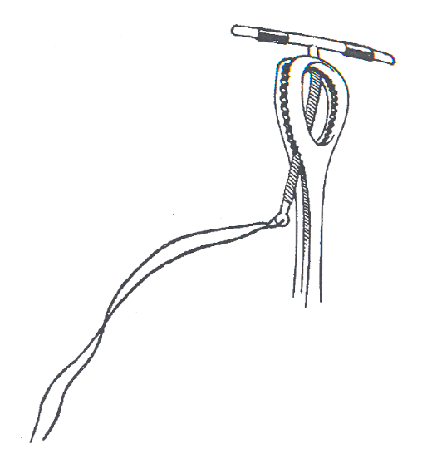
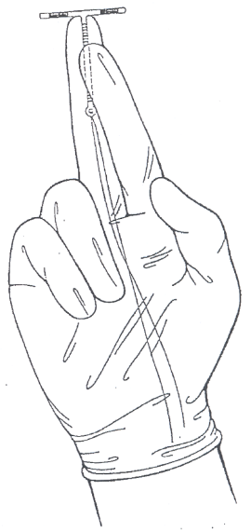
Post Partum IUCD Insertion
Grasping the IUCD with the Kelley placental forceps
Holding the IUCD before post-placental manual insertion

Slide 201
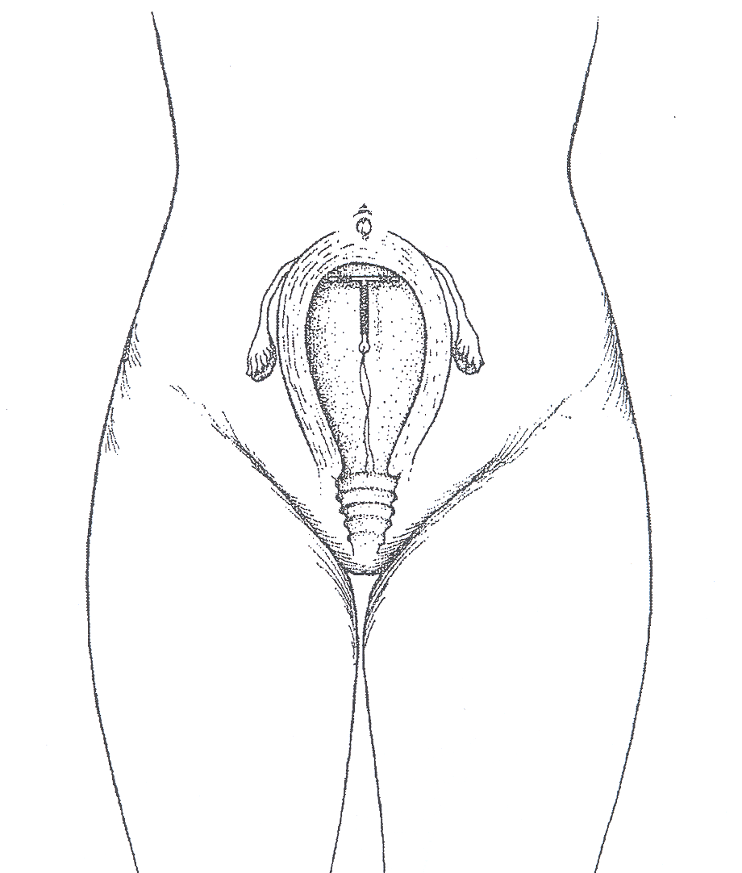
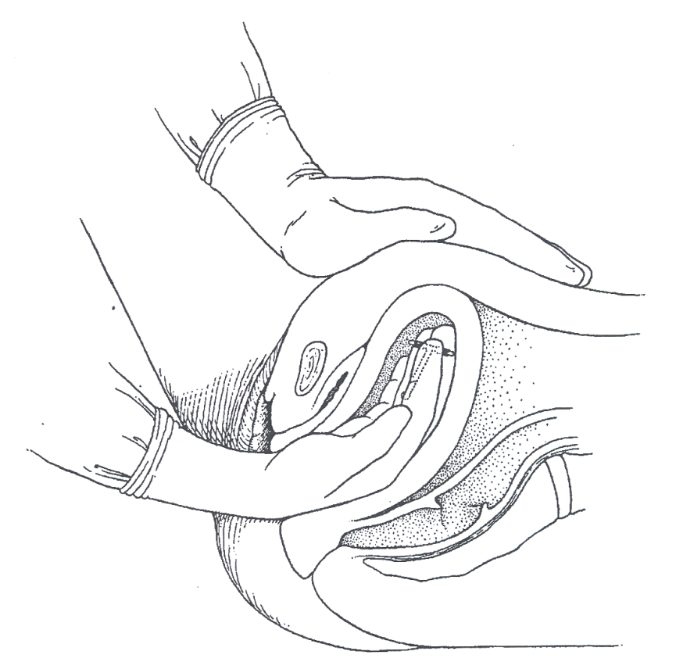
Post Partum IUCD Insertion Procedure
Location of IUCD within uterus after insertion
Placing the IUD at the top fundus of the uterine cavity

Slide 202

“If you think you can, you can.” D.A. Henderson

Slide 203
Purpose of the Medical Eligibility Criteria
To base guidelines for family planning practices on the best available evidence
To address misconceptions regarding who can and cannot safely use contraception
To reduce medical barriers
To improve access and quality of care in family planning

Slide 204
Utilization of evidence-based information
Research
Evidence
Utilization
MEC
Policies/
Strategies
Standards/Guidelines
Job Aids
Quality Health Services

Slide 205
Utilization of evidence-based information
Research
Evidence
Utilization
MEC
Policies/
Strategies
Standards/Guidelines
Job Aids
Quality Health Services

Slide 206
What Is Answered by WHO’s MEC?
In the presence of a given individual characteristic or medical condition, can a particular contraceptive method be used?

Slide 207
MEC CLASSIFICATION OF CATEGORIES
Category 1: A condition for which there is no restriction for the use of the method
Category 2: A condition where the advantages of using the method generally outweigh the theoretical or proven risks
Category 3: A condition where the theoretical or proven risks usually outweighs the advantages of using the method
Category 4: A condition that presents an unacceptable health risk if the contraceptive method
207

Slide 208
WHO Medical Eligibility Criteria Classification Categories
Classification | With clinical judgment | With limited clinical judgment
1 | Use method in any circumstances | Yes Use the method
2 | Generally use: advantages outweigh risks | Yes Use the method
3 | Generally do not use: risks outweigh advantages | No Do not use the method
4 | Method not to be used | No Do not use the method

Slide 209
WHO Classifications for Sterilization
A = Accept
C = Caution
D = Delay
S = Special
Notes:
Different classifications than for the temporary methods
A Accept There is no medical reason to deny sterilization to a person with this condition.
C Caution The procedure is normally conducted in a routine setting, but with extra preparation and precautions.
D Delay The procedure is delayed until the condition is evaluated and/or corrected. Alternative temporary methods of contraception should be provided.
S Special The procedure should be undertaken in a setting with an experienced surgeon and staff, equipment needed to provide general anaesthesia, and other back-up medical support. For these conditions, the capacity to decide on the most appropriate procedure and anaesthesia regimen is also needed. Alternative temporary methods of contraception should be provided, if referral is required or there is otherwise any delay.

Slide 210

MEC Wheel

