Slide 1
Net Map
February 15-16, 2018
Notes:
Hi everyone, and thanks for coming. I’m pleased to be participating in this training about using Net-Map. Thank you for having me.
My name is Jarret Cassaniti, and I am with the Johns Hopkins Center for Communication Programs in Baltimore. I have been with USAID’s flagship knowledge management project, Knowledge for Health (K4Health) Project, for the last five years. Part of this time was spent working with medical laboratory scientists here in Nigeria to produce eLearning courses. Last year I joined USAID’s flagship behavior change project, Breakthrough ACTION.

Slide 2
Agenda - Thursday
Social warm up
Net-Map: the basics
The 5 steps of Net-Map
Case studies and past experiences
Net-Mapping applied to your case
Lunch
Getting the question right: “Who influences XY?”
Putting the actors on the map
Defining the links
Connecting the dots
Goals of actors
Notes:
Let’s hear from

Slide 3
Agenda - Friday
Net-Mapping applied to your case
Setting up influence towers
Exploring meaning, understanding bottlenecks, identifying coalitions
The most special link: Future connections
Lunch
Transforming paper maps to computerized visuals
Reflection: How can you use all this in your work?
Evaluation Special emphasis on the technology DataMuse
PIPA process - as an add on process for developing the audience profile
Notes:
Let’s hear from everyone: 1) what experience or knowledge do you have of Net Mapping or SNA? 2) Childhood nickname?

Slide 4

Constraint to Collective Action
What is blocking implementation?

Slide 5
Stakeholder Challenges in Implementation
Incomplete Information
Unclear Actor Interest
Existence of Formal & Informal Links
Limited Knowledge of Influence
Unclear Authority

Slide 6
A Stakeholder “Influence-Mapping” Tool
Net-Mapping can help us understand
Complexity from different perspectives
Identify formal and informal networks
Bottlenecks, and reasons for success or failure

Slide 7
How does Net-Map help?
Who is involved?
What are their position?
How they are linked?
What their Influence is?
What opportunities and Constraint there are?
Whether networks change over time?
What insights emerge that can inform action?

Slide 8
The process is just as important as the product?
Net-map data are the skeleton… the qualitative information provide the substance
At the end... a map emerges that shows the people we need to work with to make progress!
When done... It provides deeper insight to inform action

Slide 9
More on the value of net-mapping
It overcomes the combined rigid traditional reporting tool used by other research methods, and brings the ability to explore data in-depth for all grades of analysts.
Net-map increases productivity, reduces lengthy analysis and associated costs. It also reduces the turn around time for research and products of research from days and weeks to mere hours.

Slide 10
Net-Map methods
Participants list relevant actors and examine links between them
Participants add wooden “influence towers” to represent power and influence of various actors
The individual (or group) then discusses the goals of each actor

Slide 11
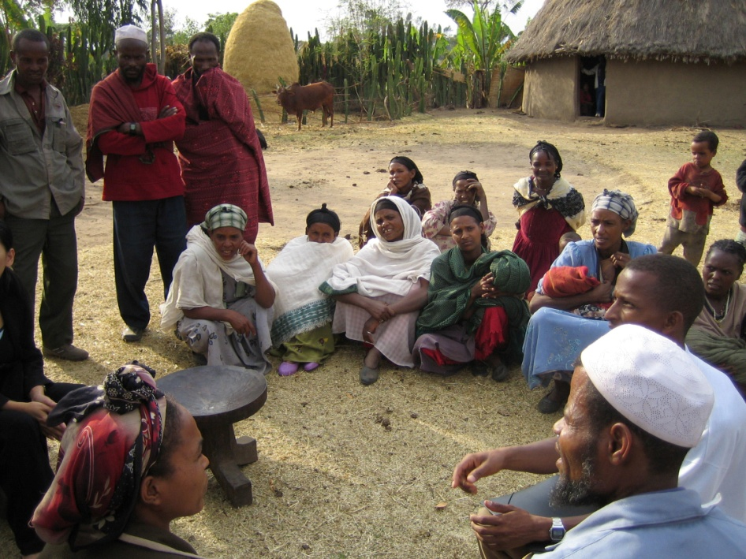
Net-Map as a Community-Building Tool
Visualizing networks, power structures, and goals makes it easier for everyone to discuss them
Net-Map concepts are easy to understand—even for community members with low or no schooling
© 2005 Virginia Lamprecht, Courtesy of Photoshare
Notes:
Net-Map is also a great community-building tool.
Visualizing networks, power, and goals makes it easier for everyone to discuss them.
The concepts used in Net-Map are rather easy to understand—even for community members with low or no schooling, thus allowing disadvantaged community members to document and express their views just as well as the other groups.
And even though the goal will not necessarily be to agree on a common map, exchanging different views can help everyone involved to work on a solution that takes all the views into account.

Slide 12
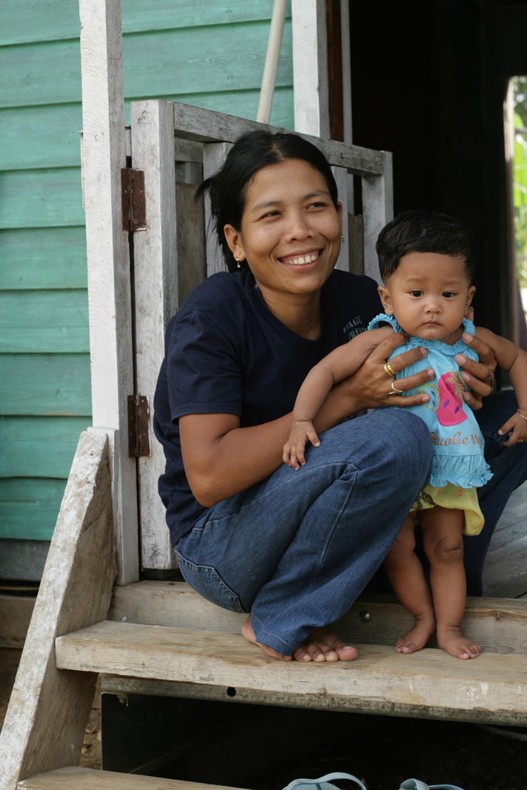
Net-Map as a Monitoring Tool
Monitoring success of a program through Net-Map
Can be used throughout an intervention or program
Conducting regular Net-Map exercises will help you understand whether certain goals have been achieved (and also how and why/why not)
Notes:
Throughout a program, you can use Net-Map to monitor the success of your intervention.
For example, you can learn a lot about your successes by drawing influence maps with stakeholders before and throughout your intervention.
By conducting regular Net-Map exercises, you will be able to understand not only whether certain goals have been achieved but also how and why (or why not) – so you can adjust the program as you go along.

Slide 13
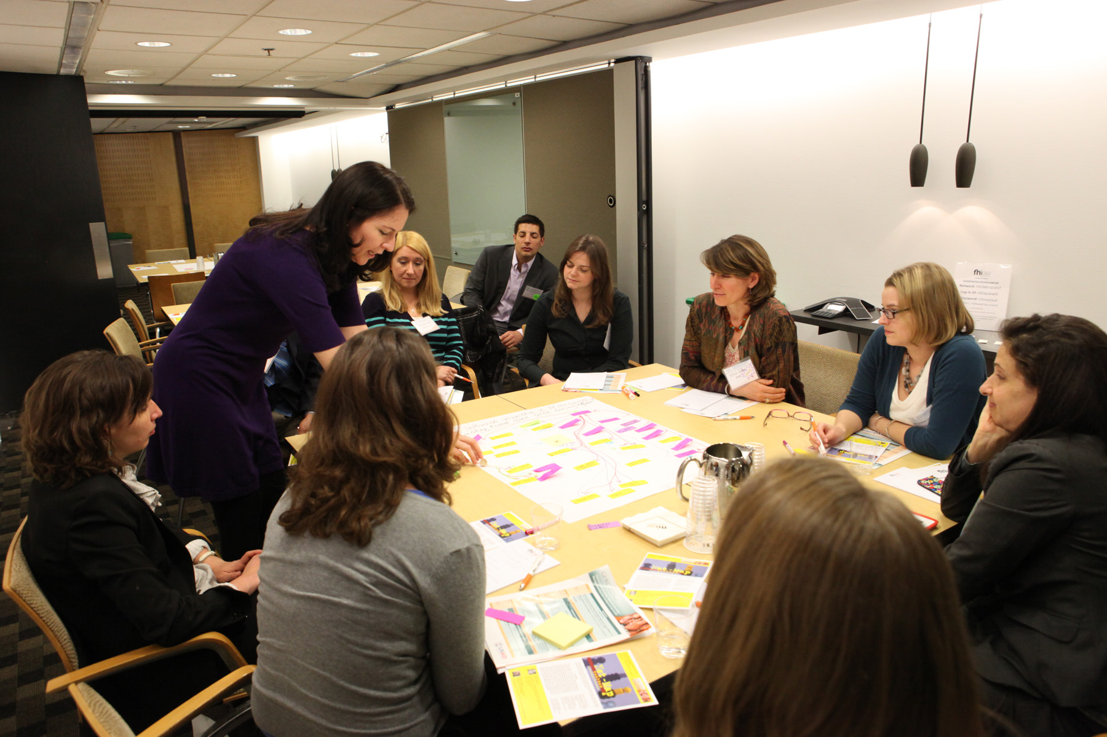
Net-Map as a Program Planning Tool
Through the Net-Map process, team members can see where they fit in the intervention process
Notes:
Net-Map is also a great program planning tool –
Through the process of conducting the Net-Map exercise, team members can see where their expertise lies, and where they fit in the intervention process
This can help groups figure out what team members fit with which activities

Slide 14
The 5 Steps
Define question
Define the actors
Define links
Define goals of actors
Define the actors’ influence

Slide 15
Case Studies
Program Implementation in Malawi
NURHI 2 in Lagos, Kaduna, Oyo
Notes:
I will give some case study examples of how K4Health has Net-Map in Ethiopia and Malawi.

Slide 16
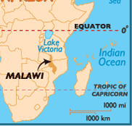

Case Study of Net-Map Used in Program Implementation: Malawi
Notes:
Another example of using Net-Map is the K4Health Malawi Pilot Project, which used Net-Map as a program implementation tool and a monitoring tool.

Slide 17
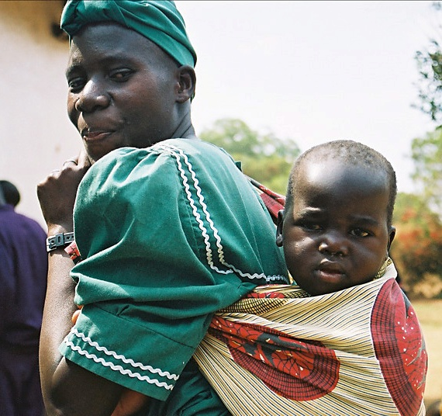
Context: Malawi
Poor maternal health and family planning indicators
High rates of HIV/AIDS
Poor health infrastructure – including communication and knowledge sharing
Notes:
In Malawi, maternal and child health indicators are generally poor, and there are high rates of HIV/AIDS. Also, there is poor health infrastructure and a lack of sharing health knowledge among different stakeholders.

Slide 18
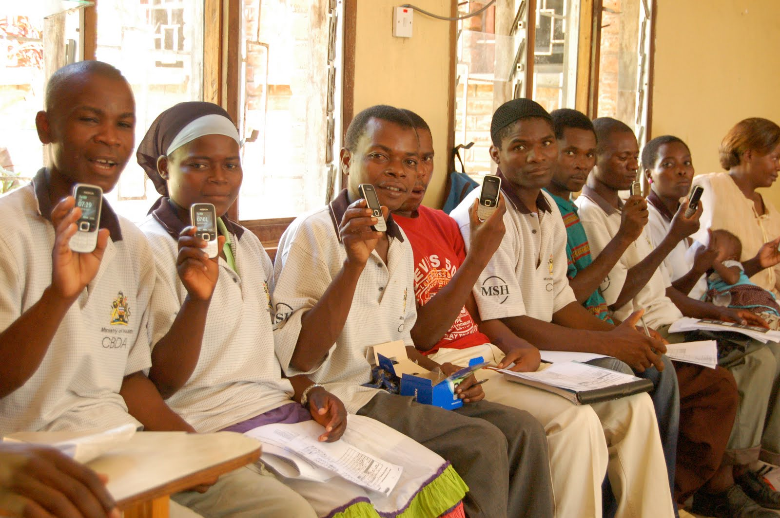
Background: Malawi K4Health Project
In 2010, K4Health began a pilot project in Malawi to address gaps in information and knowledge sharing among health providers.
Main goal: Improving access to and use of FP/RH and HIV/AIDS information among program managers and health providers.
Used mobile phones and other tools: Set up a mobile phone network to link 630 CHWs and health facilities
Notes:
In 2010, K4Health launched the Malawi Pilot Project, which worked at the national, district, and community levels to provide access to and promote the use of information for Family Planning and Reproductive Health and HIV/AIDS health workers, managers, and service providers to improve service delivery.
Main goal: Improving access to and use of FP/RH and HIV/AIDS information among program managers and health providers.
Because most health care providers, even those in rural areas, have access to mobile phones, K4Health worked with Frontline SMS and the Malawi Ministry of Health to create an SMS-based mobile phone network between district health centers and community-based distribution agents.

Slide 19
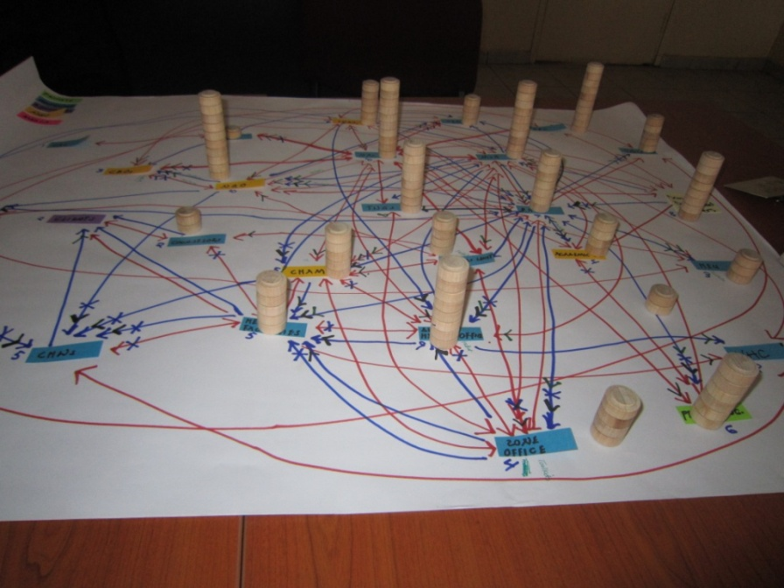
Methods: Malawi Net-Map
Net-Map was used to help implement the program and monitor its progress/success
Two district-level Net-Map workshops:
May 2010 (just as the pilot project was beginning)
June 2011 (follow up)
Photo © 2011, Natalie Campbell, Courtesy of MSH
Notes:
In an effort to include key stakeholders in the assessment and design of this project, the K4Health team conducted two district-level Net-Map exercises. This was to help implement the program and monitor its progress/success. The first was in May 2010 and a follow-up Net-Map was done in June 2011 to evaluate the impact of K4Health interventions.

Slide 20
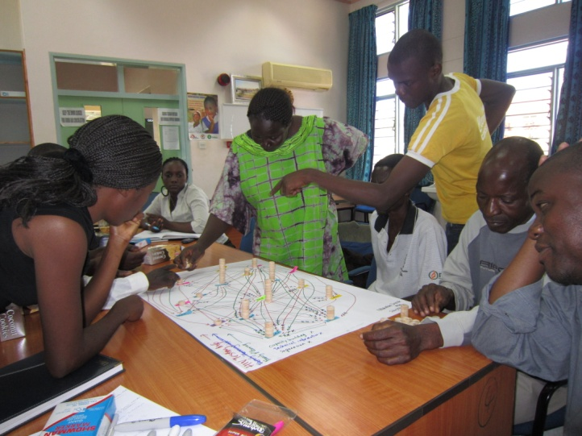
Malawi Net-Map Participants (Resource People)
District health officers, NGO district managers, health facility staff, and community health workers
Photo © 2011, Natalie Campbell, Courtesy of MSH
Notes:
The Resource People for this exercise were: district health officers, NGO district managers, health facility staff, and community health workers in two districts.

Slide 21
Benefits of Using Net-Map Results: Program Design
K4Health was able to develop activities to address specific needs
Learned about the key role of NGOs in information flow in Malawi – NGO’s step in when there is a bottleneck in information flow
After learning this, K4Health involved NGOs heavily in distributing information about FP/RH and HIV/AIDS to health workers
Notes:
These Net-Maps were beneficial to the project. They allowed the K4Health Malawi team to tailor the activities better to address information needs in Malawi. The K4Health Malawi team discovered really valuable information through the Net-Map process that would not have been revealed through an interview. For example, by drawing information-sharing maps, the team learned about the key role of NGOs in the flow of health information in Malawi. Participants explained that district hospitals get overloaded with information, which causes a bottleneck. As a result, local NGOs step in and play a large role in the distribution of information to health workers. After learning this during the 2010 Net-Map, the Malawi K4Health team involved NGOs heavily in its dissemination and promotions efforts.

Slide 22
Benefits of Using Net-Map Results: Program Design (cont.)
“The Net-Map results revealed the high level of influence held by NGOs in the community. This information led us to include NGOs in many of our project interventions and dissemination work, which we may not have done– if we hadn’t known this.”
- Natalie Campbell, K4Health Malawi Project Manager
Notes:
Here is a quote from the K4Health Malawi Project Manager, Natalie Campbell, who said that “The Net-Map results revealed the high level of influence held by NGOs in the community. This information led us to include NGOs in many of our project interventions and dissemination work, which we may not have done– if we hadn’t known this.”

Slide 23
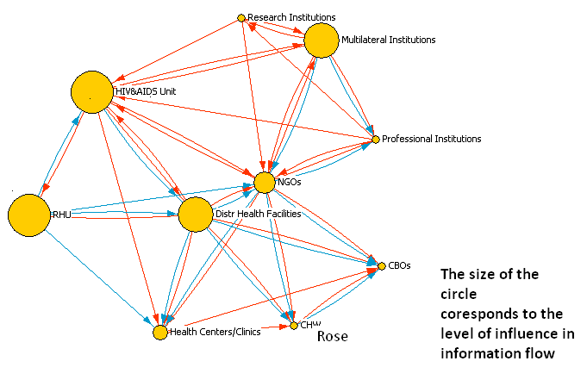
Benefits of Using Net-Map Results: Finding Solutions
Net-Map encourages active participation, and participants can suggest solutions to challenges based on the local context
Sometimes, the influence lies with the person or organization you least expect
Red – HIV information
Blue – FP information
Notes:
The process of Net-Map encourages active participation, and allows for a wide range of contributors, from community health care workers to national health officials. Net-Map participants can suggest solutions to address challenges and can provide key information regarding local context and the relative influences of various actors.
According to Natalie Campbell, who led the Net-Map exercise in June 2011, “Net-Map provides us with the participants’ view of what’s going on the ground and where they feel the influence and leverage points are. Every known actor involved in the flow of HIV testing and counseling and FP information is identified through the mapping process. And sometimes the influence lies with the person that you least expect.”

Slide 24
Benefits of Using Net-Map Results: Program Evaluation
Conducting two Net-Map exercises (in May 2010 and June 2011) allowed K4Health to evaluate the way the network changed during the project
This can allow the program staff to make necessary changes if things are not working as expected
Notes:
Net-Maps can also be used to evaluate the ways in which health information networks change over the course of a project. The two district level Net-Map exercises conducted by K4Health in Malawi (in May 2010 and June 2011) had identical formats. However, the outcomes were significantly different. Not only were there several new actors identified during the follow-up Net-Map but levels of influences also had changed.
For example, participants in the 2010 Net-Map did not mention CBDAs, health surveillance agents (HSAs), or clients as actors in health information flow. In 2011, participants not only mentioned them but also reported that these actors played a prominent role in the flow of information back and forth with each other, as well as with other institutions. When asked which links may have been strengthened due to mobile devices, the participants were quick to point out several new links that existed due to these interventions, and previously existing links that had been strengthened.

Slide 25
Overall Conclusions
Net-Map can be a useful tool for research, program implementation, and evaluation
Net-Map can provide rich data, and you may learn things through Net-Map that you would not have learned through an interview or other method
Follow-up Net-Maps can encourage meaningful dialogue and help understand program achievements and develop solutions
Notes:
There are many potential advantages to Net-Map:
Net-Map can be a useful tool for research, program implementation, and evaluation
Net-Map can provide rich data, and you may learn things through Net-Map that you would not have learned through an interview or other method
Follow-up Net-Maps can encourage meaningful dialogue and help understand program achievements and develop solutions
You may find out information you never would have learned otherwise – due to the visual cues and discussion surrounding map creation.

Slide 26
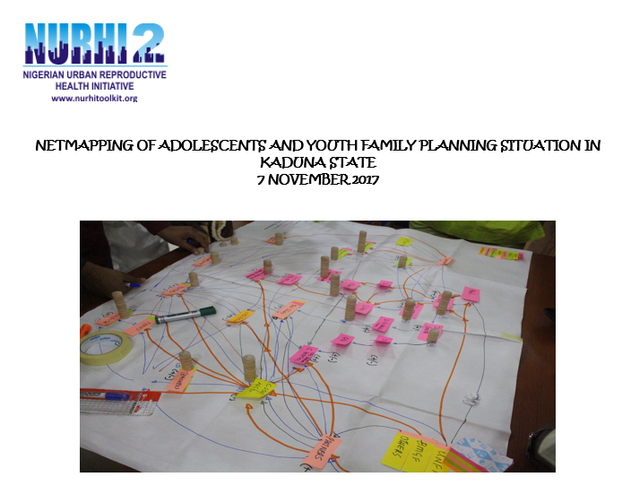
NURHI 2 – Lagos, Kaduna, Oyo

Slide 27

Questions/Discussion

Slide 28
Lets Do It
Define question
Define the actors
Define links
Define goals of actors
Define the actors’ influence
Then we’ll read the map
Notes:
Let’s think concretely about the practical in Ogun State

Slide 29
Step 1. Define One Question
“Who influences XY in ZZ way?”
XY should be a complex issue influenced by different actors with various goals, who are linked by formal and informal links
XY could be your project success, the change of a legislation, the adoption of an innovation, the solution of a conflict, your personal career etc.
Formulate XY concretely (but not too narrow)
Notes:
If the XY is “information flow”, then the links might include:
Guidelines
Report feedback
Contact information
Formative input

Slide 30
Step 1. Define One Question
Example:
In youth programming for Family planning who Influences:
whether access to services and information are available
what might be the challenge to young people accessing services and information
how might we ensure sustained access to contraceptives for young people

Slide 31
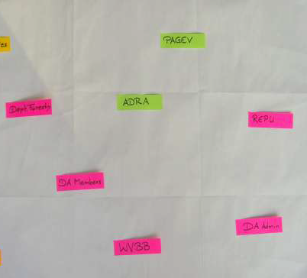
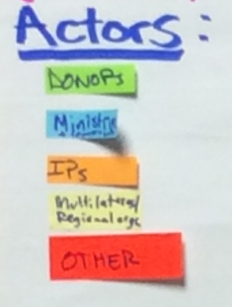
Step 2. Define the Actors
Identify which actors are influence a topic
Then group them according to their type
Assign a color to that actor type
Possible Actor Categories:
Government
Civil Society/NGO
Private Sector
Donors
Implementing Partners
Others… (Optional)
Example

Slide 32
Step 2. Define the Actors
Example
Name all individuals, groups, and organizations that can influence the issue you are examining.
Mention every actor that comes to mind, not only those who have formal decision making capacity in the process.
Do actors belong to distinct groups like government, NGO, private sector or local, regional, national level
Assign card colors to group types

Slide 33
Step 2. Define the Actors
Reduce your list it down to around 8-16 actors and categorized them into around 4-6 categories
Write every actor on cards and distribute the cards on the map. Give your stakeholders time to think this through properly. Before going to the next question, read out loud all actors, since this might make the stakeholders think of other actors to add.
In some cases, you might insist that the stakeholders add themselves to the actor list.
Notes:
If you are working with illiterate interviewees, let them pick figurines for each actor and place them next to the actor cards; this way, it will be easier for them to remember who is who. You might chose different colors of cards for different groups of actors (use pink cards for all governmental actors, for example, or green ones for all non governmental actors). This also helps to visually structure the map more clearly.

Slide 34
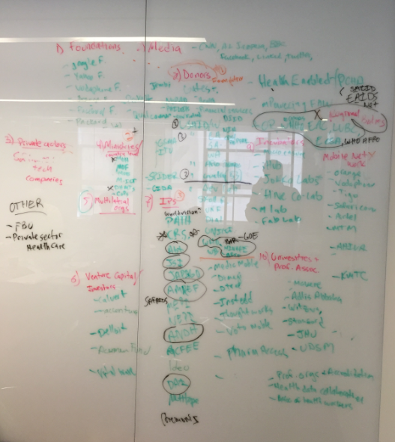
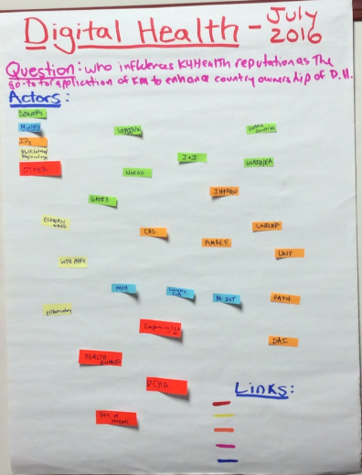
Step 2: Define the Actors

Slide 35
Step 3. Define and Draw Links
How do actors interact to influence XY?
Select no more than 4-5 links
Formal and informal links
Links that are different from each other
No links that everybody or nearly nobody shares
If you call one link giving support, define it! Some may think it means “giving words,” while others may think of “giving money”
Notes:
Depending on your issue, you might want to look at different links, such as lines of conflict (verbal,
physical), kinship and friendship links, or flow of specific products. It may also make sense to focus on
one kind of link—such as information flow—but divide it into subcategories: information regarding
research results, information about business opportunities, and information about political processes, for
example. Try to focus on the most important links and to limit yourself to no more than five. Otherwise
your network will be too cluttered. Make sure the links are very specific. If they are not, you will end up
linking everyone with everyone. See Section 2.5 for more about drawing these links.
Other potential links:
giving money
giving advice,
loving,
hating,
being family member of,
torturing,
gossiping about,
putting pressure on,
giving flowers to,
trading with,
bribing,
being friends with,
supporting,
giving information to,
having conflict with,
having formal authority over,
trusting,
collaborating,
lobbying,
competing with,
knowing,
sending emails to,
having illicit affair with,
committing crimes together

Slide 36
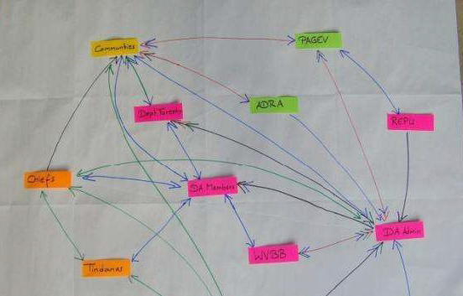
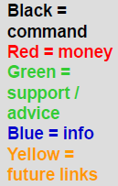
Step 3. Define and Draw Links
Example
Identify the links
Assign a color to each type of link
Draw arrow heads on each link to show direction of flow
Links could be sharing information, advice, funding, command, conflict, family ties, political pressure

Slide 37
Other Potential Types of Links
1. Access commodities
2.
3.
4.
5.
6.
7.
8.
9.
10.

Slide 38
Step 3. Define and Draw Your Links
Start with the link that you expect to be the least common, finish this color, and continue with the next. In this way the picture will develop slowly and the process will be less messy
Make sure you are NOT looking at how links should or will be, but at how they currently are

Slide 39
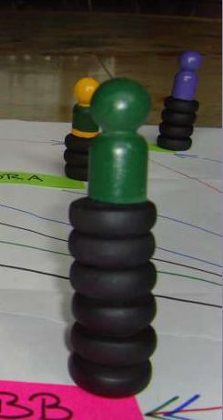
Step 4. Determine Influence
The more influence an actor has the higher the tower
The towers can be as high as you wants
Two actors can have towers of the same size
If an actor has no influence at all, the figure is put on the ground level without any influence tower
The question is: How much influence does this actor have in this specific field/activity/organization—and not in a more general sense
Notes:
For example, the president of a country will be seen as more powerful in a general sense than a district chief executive (DCE). However, when it comes to influencing the implementation of a specific intervention in his district, a DCE tends to have much more impact than the president.

Slide 40
Determine Influence
You will need to find an appropriate definition of influence that everyone agrees upon
In different cultural and political contexts, you might have to use different terminology.
Agreeing on a definition and/or terminology is especially important, since power and influence are sensitive issues in many contexts.
After setting up the influence towers, verbalize what you see, starting with the highest tower
Once your group is content with the whole set-up, note the height of the influence towers in marker next to the actors’ names on the network map
Notes:
The sources of influence could be diverse, ranging from legitimate decision making capacity, through giving advice or incentives, to bending or breaking the rules.

Slide 41
Verbalize and Document
After setting up the influence towers, verbalize what you see, starting with the highest tower.
For example: ―You have given the chief the highest tower with a height of five tower pieces, followed by the assembly man and the earth priest, both on towers of four… and finally you say the Fulani herdsmen and the unit committee members have one influence tower or none at all.
Once your group is content with the whole set-up, note the height of the influence towers in marker next to the actors’ names on the network map.

Slide 42
Seek to Understand
Go through all the actors on your map and keep in mind that it is crucial to understand not only why the powerful are powerful, but also why others are seen as having no influence.

Slide 43
Step 5: Identify Actor Goals
Do actors follow different goals concerning the question?
Develop abbreviations or symbols such as:
( + ) for positively aligned with the question
( - ) for negatively aligned with the question
( +, - ) for neutrally aligned with the questions
Notes:
Now you know who is involved, how they are linked, and how influential they are. However, if you do
not know the goals of your actors, you do not know in which direction they want to move. For example,
if you are looking at the question ―Who will influence whether or not my organization reaches this
specific goal?, you do not yet know whether the actors will use their links and influence to support or
hamper the achievement of your goal. In your preparation and pre-testing, you will have defined a
number of relevant goals you want your interviewees to examine. Ask your interviewees to focus on
each and every actor and tell you which of your pre-defined goals that actor is likely to support. Add
abbreviations or symbols next to each actor card. If you want to know who is more development
oriented and who is more focused on protecting the environment, your acronyms could be D
(development) and P (protection), as in the example below.

Slide 44
Analysis
What does this mean?
Discuss the Net-Maps you made
Look at who actively wants to support you and who wants to stop you. Some actors will be rather neutral.
Notes:
Look at who actively wants to support you and who wants to stop you. Some actors will be rather neutral.

Slide 45
Reading a Net Map
Follow your visual intuition: what is strange, unique, striking?
Initiate qualitative discussion with interviewee
But: Visual representation might be misleading, for more reliable analysis:
Familiarize yourself with basic network concepts
Transform drawn map into computerized format and embark on quantitative analysis
Notes:
Degree Centrality (number of links)
- Eigenvector Centrality (links with actors with high degree centrality)
- Betweenness Centrality (linking actors not otherwise linked) and
- Closeness Centrality (length of path to every other actor in the network)
While it is rather easy to determine the degree centrality (by counting links), the other centrality
measures require more complex mathematical operations. Network analysis software provides these and
a great number of other formulas to help you analyze your data. In most cases, you are required to
transform the map into a matrix (though some programs, such as VisuaLyzer, also allow you to actually
draw the map and they develop the matrix for you).

Slide 46
Conducting Participatory Impact Pathway analysis
Kabir M. abdullahi
Oris Ikiddeh
Jarret Cassaniti

Slide 47
Participatory Impact Pathway Analysis (PIPA)
A practical planning tool
Starts with assumptions of how the project will make an impact
Participants construct problem trees, carry out a visioning exercise and draw network maps to help them clarify their ‘impact pathways’.
These are then articulated in two logic models.
The outcomes logic model describes the project’s medium term objectives in the form of hypotheses: which actors need to change, what are those changes and which strategies are needed to realise these changes.
The impact logic model describes how, by helping to achieve the expected outcomes, the project will impact on people’s health.

Slide 48
PIPA
Participants derive outcome targets and milestones which are regularly revisited and revised as part of project monitoring and evaluation (M&E).
PIPA goes beyond the traditional use of logic models and logframes by engaging stakeholders in a structured participatory process, promoting learning and providing a framework for ‘action research’ on processes of change.
The two logic models provide predictions of future impact which can be used in priority setting. They also provide impact hypotheses required for ex-post impact assessment.

Slide 49
PIPA QUADRANT PROFILING

Slide 50
Steps in conducting PIPA
Step One:
Identify the stakeholders
Find out how much in agreement they are with the program
To what extent is it a priority for them to act on?

Slide 51
Steps in conducting PIPA
Step One
Step Two:
Identify the challenges
Circle the most powerful ones or the most influential ones within the system

Slide 52
Steps in conducting PIPA
Step One
Step Two
Step Three:
Identify the strategies
Supportive
You want to transform them to Community of Practice/Core Groups
Engagements, Involvement, Strategy development, share information
Neutral
Evaluate the situation
Opponents
You want to try to change belief
May decide to leave alone if they prove difficult; for some, the more you try to change them the more they become obstinate, and become an obstacle.

Slide 53
Participatory Impact Pathway Analysis
High
Develop Enthusiasm to address the issues of interest
Keep Satisfied
Learn in partnership
Build into a community of practice
Keep Engaged
Alignment
Develop awareness and enthusiasm
Monitor
Challenge existing belief
Keep Informed
Low
Interest
High

Slide 54
Participatory Impact Pathway Analysis
Use the above PIPA to figure out the ACTORS
Figure out what their POSITION is
How to ENGAGE the actor

Slide 55
Participatory Impact Pathway Analysis
Summarising the process/How to do it?
Agree on objectives
List the key actors
Locate them on the matrix
Identify the most influential actors
Identify ones you can influence
Map where you would like them to be and what you could do to get them there
Discussion:
What insights have we learnt?
What can we do better

Slide 56
Participatory Impact Pathways Analysis: a practical method for project planning and evaluation. Available from: https://www.researchgate.net/publication/237079470_Participatory_Impact_Pathways_Analysis_a_practical_method_for_project_planning_and_evaluation [accessed Feb 13 2018].

Slide 57

Questions/Discussion

Slide 58
Thank you!

